Slide 1
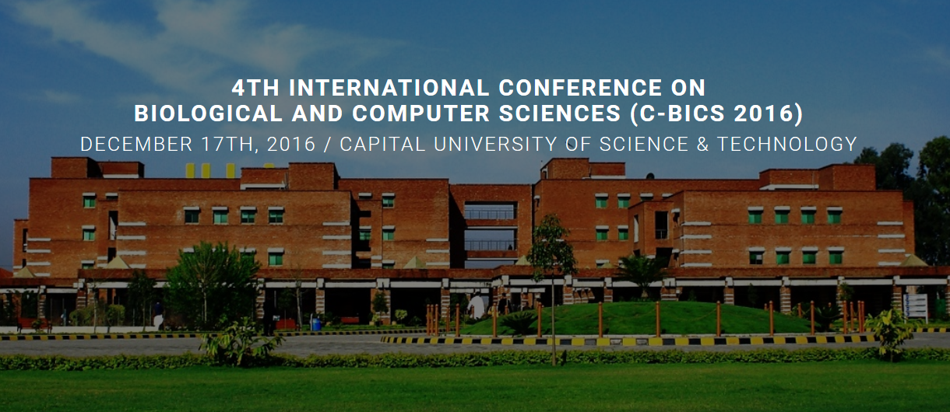
New technologies: Pros and Cons
Invited talk by Hermann Maurer Graz University of Technology, Austria, Europe

Slide 2
Some dangers (not only for) Pakistan
Death of Pakistani due to air- pollution since 2015 (by WHO): ca. 400.000 (Due to the use of fossil fuel for heating, cars and electricity production)
Death of Pakistani due to nuclear power generation 0
2012 Figures: Pakistani nuclear power plants generated 4% of electricity in Pakistan, compared to 62% from fossil fuel and 33% from hydroelectric power.
Plans to construct 32 additional nuclear power plants by 2050.
This would eliminate need for fossil fuel and much reduce air pollution.

Slide 3
Why did I start with this slide?
Because we have to minimize the dangers indicated
--- Better traffic systems
--- Less air pollution
--- Population growth and higher living standards require more food
--- Population growth and higher living standards require more clean water
For this we need all kinds of new technologies. But above all:
Much more energy without endangering environment.

Slide 4
Why do we need more energy?
--- More people
--- Need more food and water --- Want higher living standards
--- Automation is necessary but also requires engery --- Only with energy can we control climate and make use of resources beyond our planet
Radical methods required for:
--- Desalination
--- Cleaning the environment
Like, how about considering CO2 not an enemy, but a valuable resource?

Slide 5
Large-scale computer simulations show that obvious alternatives for
producing more energy and storing it are not enough.
Hydropower: great, where possible Nuclear fission: save, yet psychological resistance in some groups
Fossil fuel: great, mainly if we can handle CO2
Fotovoltaic: doubtful, despite all kinds of new ideas like solar roads
Solar-heat: good, if energy storage can be solved
Windenergy: mediocre efficieny, engery storage problem
Others: Tidal-hub power, bioga, wood/pellets, kinetic or potetial energy
We need other methods!!

Slide 6
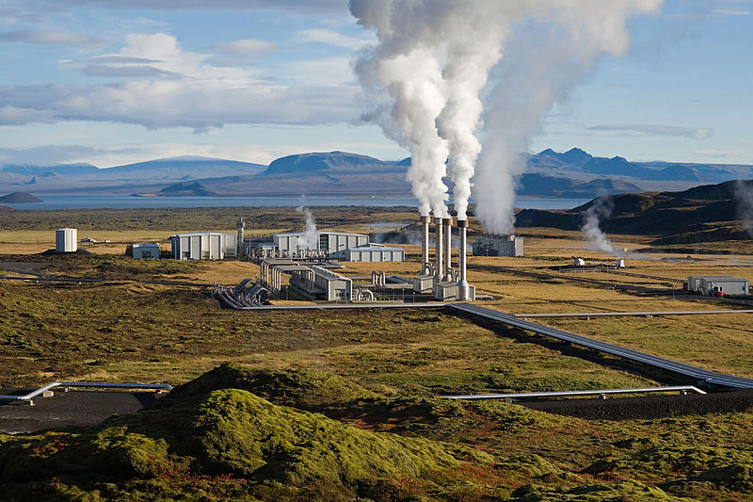
Geothermal Energy
Earth radius some 6.700 km. Converting heat in 30 km upper crust gives enough energy for all of Mankind for 100.000 years
Sierd Cloetinhg: “Geothermal power is cost effective, reliable, sustainable,
and environmentally friendly, but has historically been limited to areas
near tectonic plate boundaries. And at the moment is negligible (2%)
in the global energy mix”.
6

Slide 7
Fracking (Fracturing)
To recover remants of oil, or oil to thick to pump or to get access to shale-gas or to get access to geothermal energy.
EASAC Report: Mit „best practices“ safe to use and can be also used for producing geothermal energy.
Dangerous only if some geological facts are not taken into account and wrong chemicals are used.
Main problems: 1. Many drill- holes
2. Methan gas escapes
3. Water pollution
7

Slide 8
Fusion Energie
Fusing two Hydrogen atoms into one atom of Helium (as the sun does it). The loss of mass in this process provides huge amounts of energy
due to the formula E=mc , usually attributed to Einstein (1905)
2
When will Fusion be a reality?
In 1970 we were told in 50 years. Today we are told in 50 years.
Room for hope since in additon to traditional hyper-large projects like Magnetized target reactor: USA or the Tokamak (ITER)
NEW smaller versions are on the horizon: Collider Fusion (Tri-alpha reactors)
8

Slide 9
A key for success of mankind will be whether we learn to properly handle CO2!
It is often said: Reduce emissions of CO2. This is a misunderstanding.
Our real efforts have to make sure we can filter CO2 from the air
(Carbon Capturing and Storage) and store it, until we learn how to use it.
Many alternatives. Here is a simple and now realistic one: Some algae are converting 10 times more CO2 into bio- mass than the usual green plant. Thus, using algae we can reduce CO2 content in the air, in the process creating food, fertilizer, pharmaceudicals, and much more.
5% of CO2 generated world-wide is created by human breathing. One person/week generates as much CO2 as burning of 5 l of gasoline.

Slide 10
Remember also: Global warming may well be man-made:
2 billion humans in 1930
10 billion in 2050
Some climatologists claim that global warming will raise level of oceans by
a foot or more.
Great! If we have enough clean energy we can finally desalinate ocean water in large quantities to water the dry areas of Pakistan, of Peru, the Sahara,
parts of China,…. and provide clean water for 800 million people currently without it!

Slide 11
In addition, the role of CO2 is not really understood.
Current air content is 0.04% (400 ppm) , but has varied a lot in earth‘s history. Many plants grow better at 600 ppm!
CO2 is considered main greenhouse gas. But there are worse greenhouse gases (methan) and some that have a much higher percentage (water vapor). Hence the role of CO2 concerning global warming is probably sometimes exaggerated.
Also, if there is serious gobal warming some areas will suffer, others may win. So many parameters are involved that really realiable statements are uncertain. Like: Warmer air carries more humidity. This will mean more rain in some areas!

Slide 12
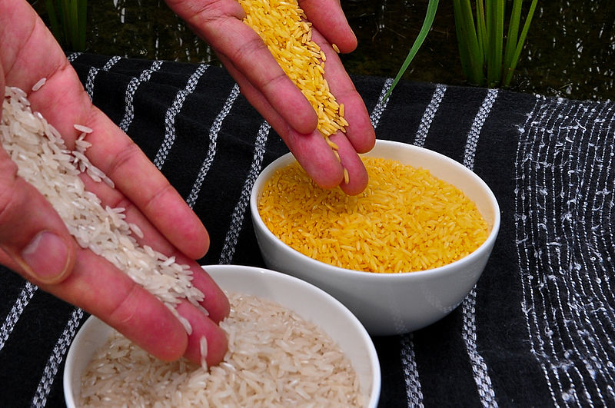
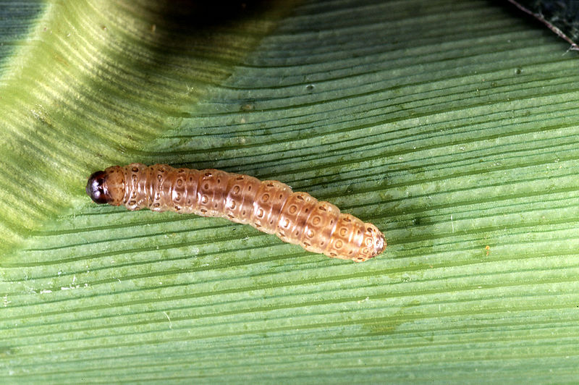
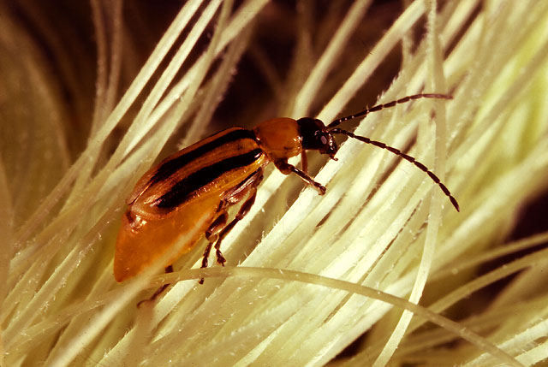
From an agricultural view may be global warming is less important than effective genetic engineering! My plea is for systematic use of genetic engeneering from
red, to gray, to white , to blue, to green.
The „green version“ (agriculture) is the one most often criticized in Europe. However, genetic engineering is better controllable than breeding; and many positive results like golden rice have certainly been achieved (ß-Carotin).
Opinion in Europe: Influenced by US seed companies.
„Genetic Corn “(Bt-Corn): reistent against catterpillar and insect damaging roots.
Ordinary and golden rice
Ostrinia nubilalis (corn worm) Diabrotica virgifera (Western corn root worm)

Slide 13
Now let me switch to some more direct aspects of information- and
communication technologies (ICTs): Research so far was mainly
cause oriented. Decisive breakthroughs were due to geniuses. Both facts will be much weaker in the future.
Causality is getting lost due to large data. We often do not ask any more WHY something happens, we just KNOW that under cirtain circumstances some events are bound to happen.
Breakthroughs not by individuals but by groups, often not co-located Einstein already predicted this phenomenon of team-work that is supported by certain
no-nonsense social nets like Declara, Slack, Pinterest, and many others.
Which technologies do we want, which do we not want?
13
Notes:
13

Slide 14
Basic question: Is technology not always ambivalent, i.e. can be used for or against people?
No. Technology is not ambivalent. Each one fits into a spectrum from „mainly good“ to „very dangerous“.
Which technology has changed the world most?
Many will say „computers“ . I believe this is not true, it rather is communication
(networks) providing information and connecting persons and computer. (we learn about things yet cannot have them; finance, commercial imperia, wars, traffic,…)
Let me now turn to one of the many things that sound like Science Fiction yet will become reality sooner than expected. I will talk a bit on autonomous cars on Monday. So let me choose another topic today.
14
Notes:
14

Slide 15
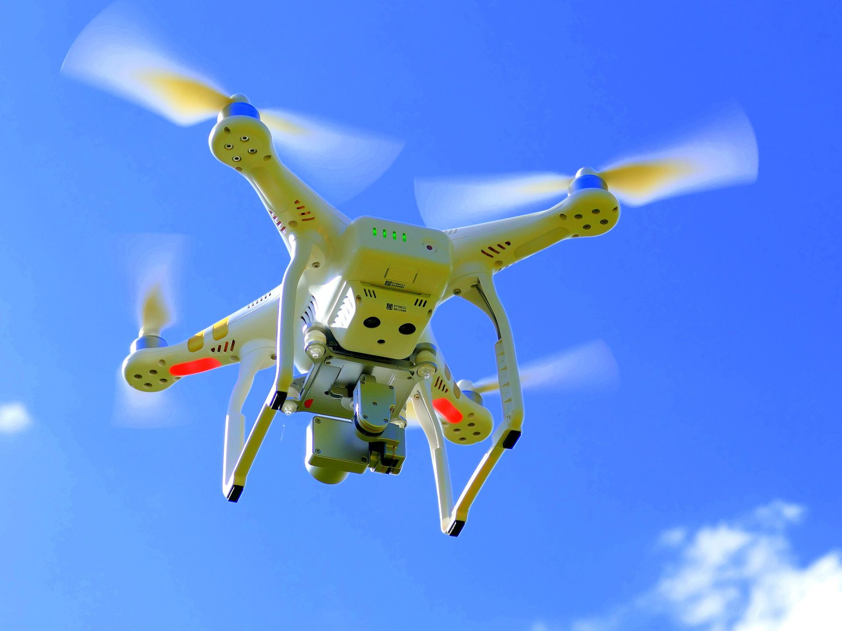
Drones
Some positive applications but also some very sinister ones.
--- Military drones including weaponized ones
--- Ideal tool for areal photography and volography, but also for reconnaissance (can be good, or bad, or immoral)
--- Potential for the transport of goods for emergency or commercial purposes
Photo: https://pixabay.com/de/drohne-quadcopter-quadrocopter-1579120/ Pixabay

Slide 16
Drohnes for commercial delivery purposes
I am choosing this example since the center of development happens to be in Graz,
based on a research group (under Professor Leberl) that was involved in high- resolution images of earth and their analysis.It was purchased for huge sum by Microsoft.
However, the whole group was soon purchased by Amazon! Many problems to be solved:
--- Sensors
--- Picture analysis
--- Communication
--- GPS
--- Colision avoidance
--- Mechatronik
--- Huge amounts of Data
--- Huge amounts of SW
--- Air traffic control problems
--- Data protection/privacy problems
--- Procedure in case of mechanical malfuction (parachutes?)
--- Cyberattacks
--- How to deliver goods to an appartment on, say, floor 3, or if nobody is home?
System almost set to go! No „real“ AI like HI is needed!
Delivery to and at beacon! Within Graz 20 minutes after ordering!

Slide 17
Dangers of the WWW and ICTs
--- Total loss of privacy
--- Search-engines and Wikipedia define a world for us (Personalisation) that may be quite remote from reality, or even give us wrong facts
--- We live in an interrupt society, hardly able to lean back and
think seriously for a long time
--- We waste our lives with trivialities and have become very impatient
--- The speed of development of technolgoy is dictated by commercial and military interests
--- Cyberattacks are bad; a cyberwar might be worse than a nuclear one
--- E-Learning and computers/ smart phones in school are much overrated
--- The wisdom of the crowds may well be then end to serious creative work

Slide 18
One addititonal big danger: Too much reliance on technology
„... and then one day the internet collapsed…“

Slide 19
Chances of WWW and ICTs
--- Potential to access new and different knowledge when we are able to cross barriers, including languages
--- We do have access to research results and can communicate with other researchers like never before, but we need open access
as much as is possible….
--- Try to use reasonable social networks like declara, Pinterest, slack,….
--- Wishful thinking: Can we still change the world by more objective
knowledge repositories like global-geography.org?

Slide 20
What can we learn from WWW history and current WWW?
--- New search engines must only allow clear queries (or suggest alternatives)
--- Data consolidation by participation of community
--- Direct feedback to information providers
--- Can we fight SPAM?
--- How can we handle mini-payments?
Major problem the world is facing (at least in Europe): Politicians
prefer to invest in subsidies to get votes, rather than to invest in what
is really important. And some big companies and others are holding
back research to protect themselves.

Slide 21
I have concentrated in this talk on energy, environment and ICT. Let me
finnish by metioning a few developments in totally other areas, that
may change humanity.
Graphene
Carbon can crystalize in a 2 D version, discovered 12 years ago at U. Manchester (Nobel prize).
Very unusual properties. E.g. Graphen Oxide allows to filter water almost without energy.

Slide 22
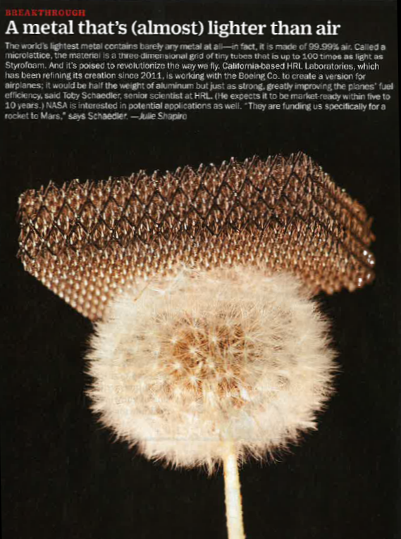
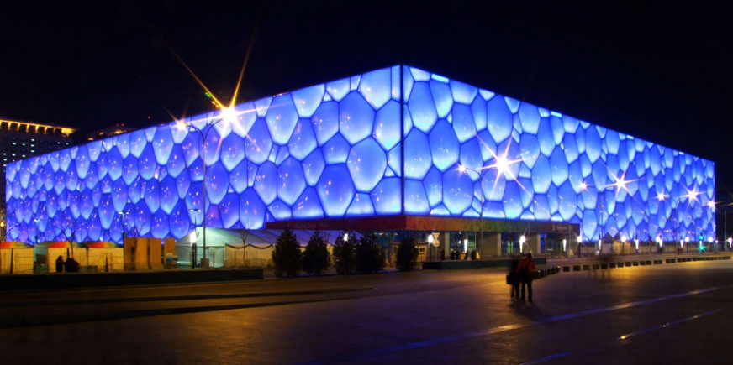
Other new materials
Bejing Aquatic Center
Professor Denis Weaire
22

Slide 23
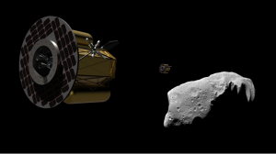
Asteroid mining
http://www.planetaryresources.com/
Asteroids with high percentage of rare elemenst (Palladium, Iridium,..) are known.
Attempt (solidly funded) is to mine one beginning 2040. Leaders in this enterprise/high risk investment are Eric C. Anderson (founder of Space Tourism), Peter Diamanidis, and others.
23

Slide 24
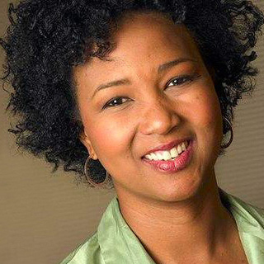
Generation Spaceship
For 5.000 – 10.000 people that can live (as generations) arbitralily long, e.g. 100.000 years.
Basic research over 100 years, but useable results expected much earlier.
Dr. M. Jemison, Director, 100YearSS,
http://www.100yss.org/
She is Dr. med. and American Astronaut
Financed by: NASA, JPOL-Caltech, GeoEye, Data SIO, NOAA, Gebco, Image IBCAO, Image Terrametrics, and others
24

Slide 25
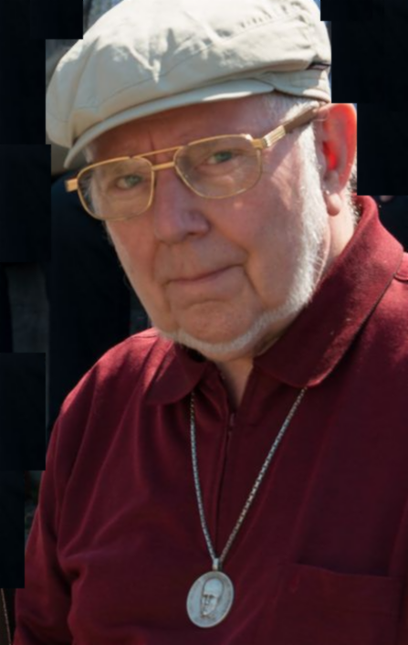
Thanks for the invitation to give a talk and for listening!
URLs: iicm.edu/maurer ae-info.org/ae/Member/Maurer_Hermann
E-Mail: hmaurer@iicm.edu

