Slide 1
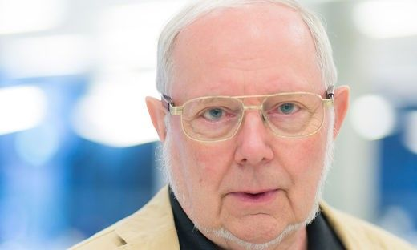
Digital documents should allow different types of interaction
Hermann Maurer Graz U. of Technology Austria
First presentation for the National Academy of Montenegro
February 2023 Podgorica

Slide 2
Collections of digital documents (like in large websites or digital libraries) are superior over printed material for users most often only in two ways:
--- access is possible 24 hours a day
--- they can provide multimedia material beyond text and pictures
Of Course they can provide more information for the information provider
(like what is accessed how often for how long). However, in my talk I will concentrate today on user aspects.
Let me start with what happened to me recently:
I wanted to contact an airline about an issue I could not find on their graphically impressive Web-pages

Slide 3
I found on the server:
--- Huge amounts of information and advertisements for special deals
--- A variety of newsletters
--- A questionnaire about my experience with my last booking process
--- A questionnaire about my experience with my last trip
--- A long list of FAQs (none relevant to my case)
I did not find:
--- an email address I could write to
I did find (hurrah!)
--- a phone number
--- however, when I called: 15 minutes of music, then an incompetent person, forwarding me to a competent person, another few minutes of music, then…

Slide 4
A message:
Sorry, the person is on holiday

Slide 5
I am running a large (1,4 million multimedia objects) information server myself: austria-forum.org . Part of a typical page looks like this:
Notice: Every page has an author with an extensive vitae, so users can judge credibility. Every contribution has a „Feedback“ button. More on this later. But let me first show you a bit of our austria-forum.org

Slide 6
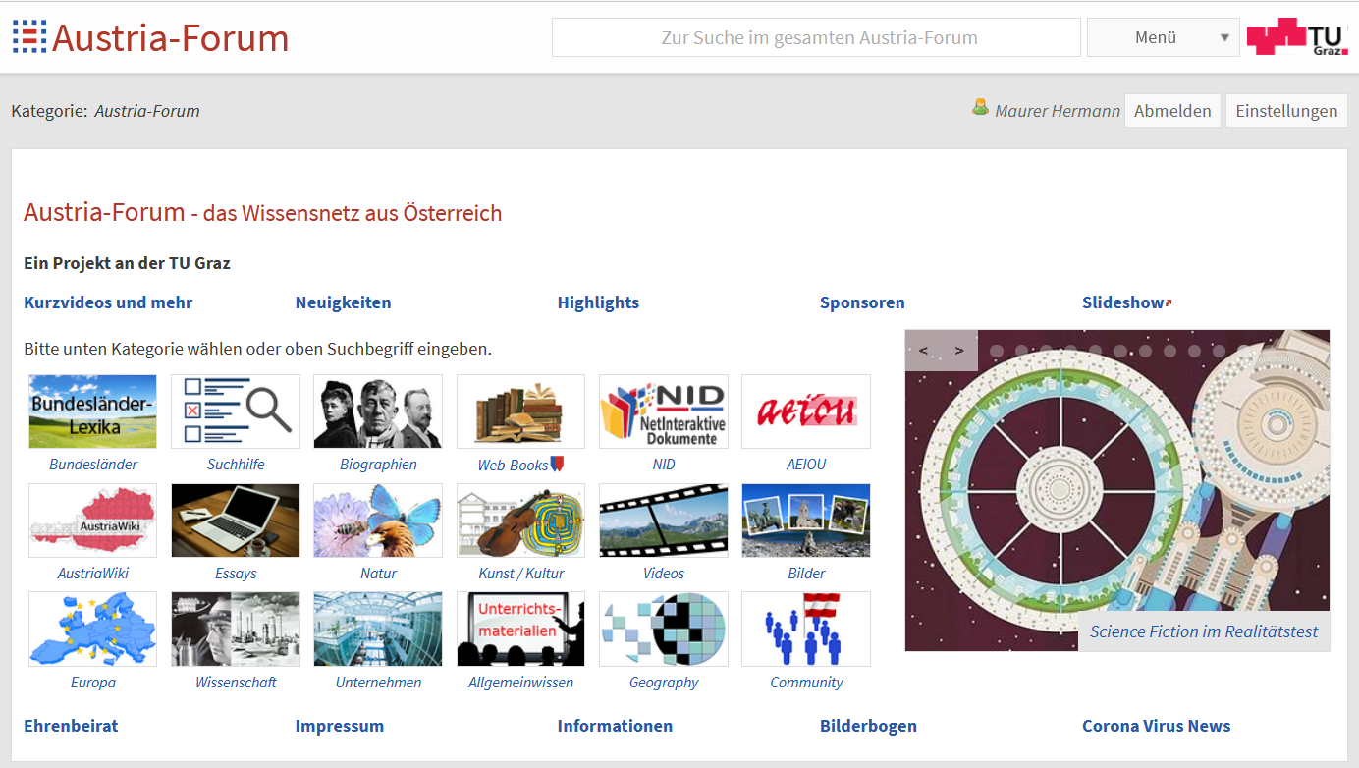
Note:
There is a
A general search field
but there are also many „categories“ to choose
from.
Why?
To avoid too many
answers that are not fitting

Slide 7
Suppose I am looking for a flower like Enzian (gentian). I will be overwhelmed
with hits.
Hence: First choose „Natur“ (nature):
And then „Flora“ (plants)
And then search for the flower you are interested in. Let us choose „Seidelbast“.We get pictures, botanical information and at the bottom an entry: A c A click leads to the page of a book:

Slide 8
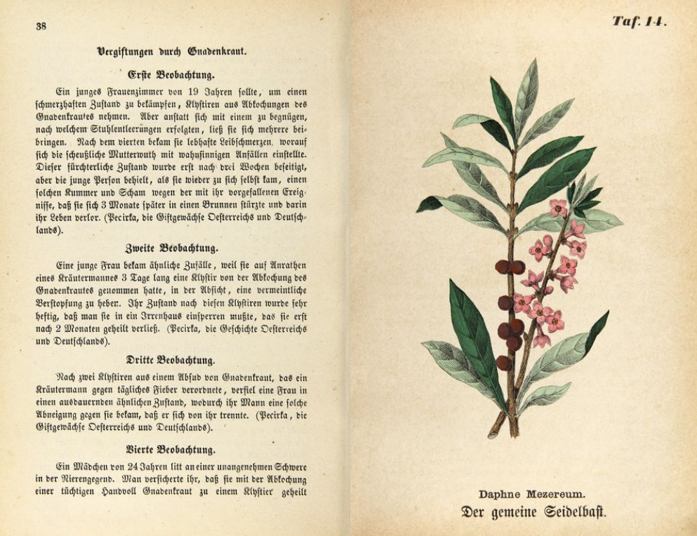
Maybe many of today's pupils
cannot read this old font any more.
One click an it is converted to a modern font.

Slide 9
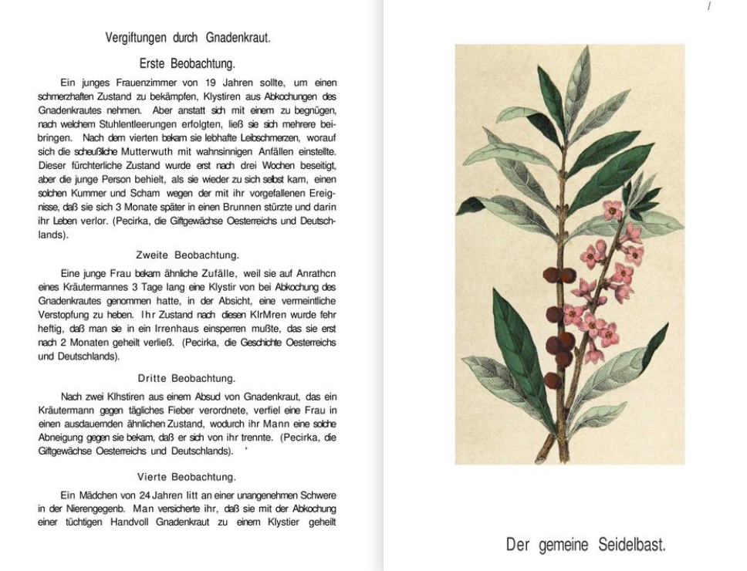
So you have seen by now three advantages of our system vs. e.g. Wikipedia contributions:
--- They have an author or reliable source
--- They can use one of 4.000 books for more explanations
--- Each contribution allows to send a feedback
--- We will show a bit of this and more in the second part (live demo), but now return to the issue of Feedback

Slide 10
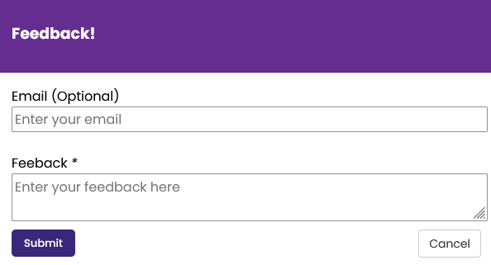
Example of Feedback button:
Note: Author of feedback is unknown except if E-Mail address is provided (e.g. to receive an answer)
My challenge to the WWW world: Every page of every server should have a feedback button!
Why is this not done? … Because there is a fear of a flood of feedbacks!
However: First, flood on „ordinary issues“ does not happen. Second, CRITICAL, feedbacks to pages or a group of pages must not go to one person, but to few persons familiar with the material at issue.

Slide 11
By the way, such feedbacks have helped a lot to improve our information server austria-forum.org
with 1,4 million media objects, some technical innovations and a slight Austrian orientation one of the more interesting Web resources in Austria.
Great? Not quite.

Slide 12
Two problems emerged when I used the system:
One, I got the same questions over and over.
Two, to avoid it, it would make sense to add a paragraph, a picture etc.
However, this would destroy all the formatting, potential links, the page numbering, the table of contents, etc., particularly in large documents on a server (in a database)
Hence, my friend and former student Dr. Bilal Zaka and I decided to design and develop a completely new system NID, standing for Net Interactive Documents

Slide 13
The basic idea of Net Interactive Documents (NID)
--- A NID Document offers a feedback button on every page
--- The crucial idea:
One can highlight any area on a page (even in a picture). When readers move their mouse to such a highlight called „annotation“, a window opens that is overlaid. It can contain text, pictures, links, clips or a combination thereof (opening new windows if necessary). Thus information can be added to the document later. All this can also be done by users, but never destroys the underlying format or content of the document; the owner of the document decides for whom the additions („annotations“) should be visible
--- As the system developed, many other sophisticated functions have been added. Some will be discussed later. But first: A simple introduction.

Slide 14
Summarizing :
By allowing feedback of users directly to experts, large (collections of) large documents offer more interactivity.
By allowing anyone (in a controlled fashion) to add „annotations“ (text, pictures, links, clips,…) anywhere, the information in documents keeps growing. Also, the owner of the document can see what is often studied and what is ignored. The author can thus potentially expand some sections by annotations (explanations). And by using links to pictures, rather copying them, almost any picture on the Web can be used in annotations as you will see. Also, NID allows communication between users, and users and authors.
… and NID offers much more, some features to be mentioned a bit later

Slide 15
NID has many application areas such as:
--- Advertising reports on achievements in organizations or government institutions (see e.g. https://www.nid-library.com/Home/Collections/37)
--- Support of E-Learning including use of groups (see e.g. page 31)
--- Conference proceedings and journals, see e.g. https://www.nid-library.com/Home/Collections/31
--- Digital libraries (see e.g. https://nid-library.com)
--- Company internal and external documentation (see e.g. page 32)
--- Touristic information (see e.g. https://www.nid-library.com/Home/BookDetail/857 )
--- Support of ordinary Web Servers (see e.g.
https://austria-forum.org/af/Biographien/Fuchs,_Ernst_(geb_1851)
--- IT learning in schools or other educational institutions (see e.g. the following pages 16-23 describing a project that obtained an award by the ministry of Education and Research)
A number of examples will be shown life in the second talk.

Slide 16
Dr. D. Camhy and I have used the system e.g. in the „FIDEL“ Project with a school South of Graz:
We asked students what topics they are interested in.
We would then prepare a list of documents for each topic, ask the students to study them and add annotations (comments).
The main topics for the first group turned out to be the following.

Slide 17
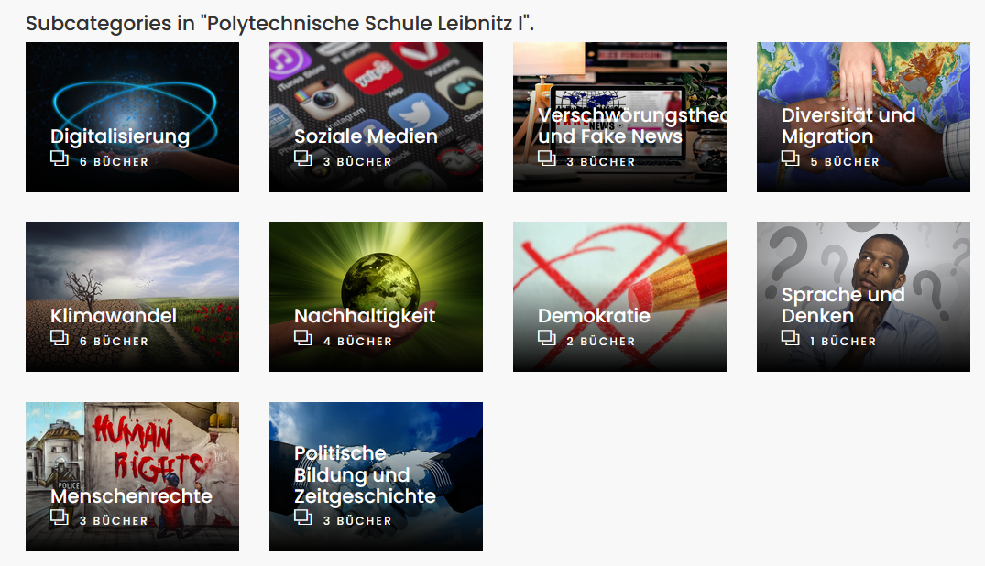
Let us look as an example at a part of one page of one document in the section Klimawandel (climate change)

Slide 18
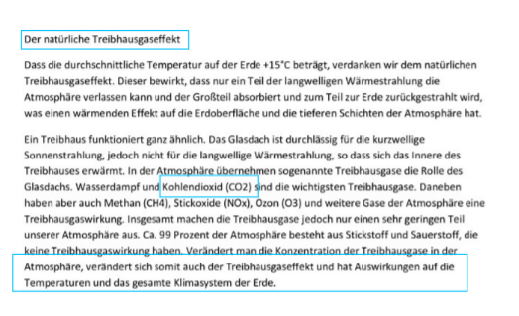
Everything you see in a bluish rectangle indicates that a student made an annotation.
Clicking at the third one would show a movie on the change of the atmosphere because of emissions greenhouse gases.
But let us have a closer look at the second entry.
Example taken from page
https://nid.kinderphilosophie.at/Home/ViewBook/253/2/view

Slide 19
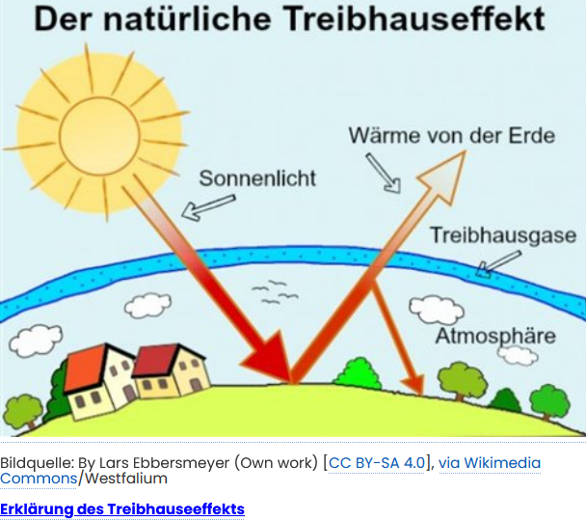
You can see that the student has used a picture that she was allowed to use under a Creative Common License, added where it came from, and a link to a major contribution on the Greenhouse effect.
However, one crucial aspect of NID is that even pictures that cannot be copied because of copyright can
usually be used in annotations, by not copying them, but by just
incorporating their graphic address.
For the observer it looks exactly like the picture was copied, but actually whenever the annotation is activated the picture is shown on the original server. This is completely legal… exactly as legal as links are in general.

Slide 20
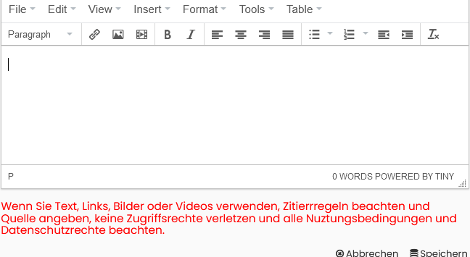
To understand this, let us briefly look at the annotation process. You highlight a spot where you want to add something. In doing so, the following window appears:
You can now enter a text (do not plagiarize!).
A click at the link icon allows to add a link and a description.
A click on the picture icon next to it gives the form shown next.

Slide 21
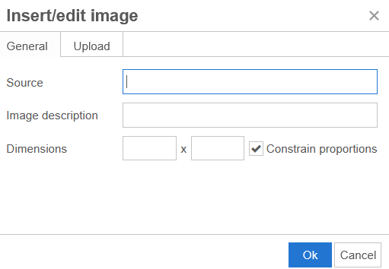
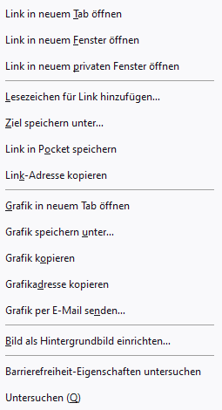
In this mode you are not expected to upload
a picture. Rather just about any picture on the WWW offers (right click with mouse) what you see to the right, the option to copy address (Grafikadresse kopieren)
Doing so allows you to incorporate almost any
picture without copyright
violation!!
In contrast, if you choose the option Upload you can
upload any picture, but you must not upload a picture unless it is yours, or you have permission to use it (it is open source, or under CC or such)

Slide 22
We have found that using this NID approach with quite young students they suddenly:
--- enjoy reading (short, interesting contributions) , since they learn and have to be active and others see what they have accomplished
--- learn how to use computers and certain software aspects
--- get an understanding of plagiarism and copyright
--- some have said this is as much fun as computer gaming

Slide 23
NOTE:
We have found that making interesting documents available to students and challenging them to find and add material is possibly the best way to:
… make students „computer and internet fit“
… allow communication that is controlled, eliminating hate postings and fake news
… makes student understand topics as „side-product“, i.e. makes general learning a pleasure
This has worked well for school and university students, and can be reinforced by offering rewards (e.g. better grades, diplomas, gifts, … ) for those doing a good job

Slide 24
Let us now look at some other important features.
You will find quite a few documents on our sever https://nid-libary.com So you can test, if NID digital-library is suitable for you.
We can install a separate part for you on our server: Then you have no installation or update worries, but of course you can also have your own NID server as Dr. Camhy has done for the school application discussed.
For now, have a look what you get when going to the main https://nid-libary.com server.

Slide 25
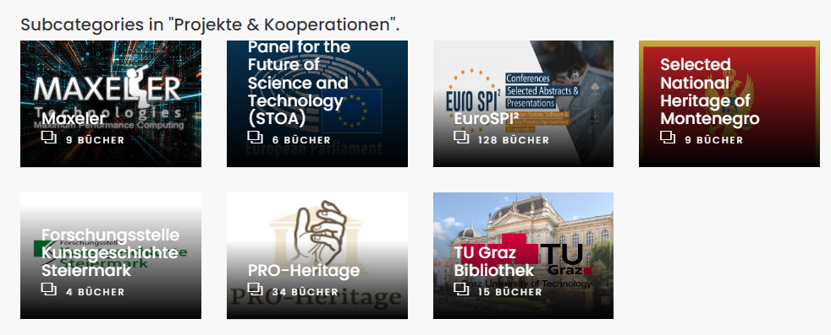
Here is the entry page of one of NIDs main server: nid-library.com. The first row shows books “rotating” by priority (too time consuming to explain here).The one on the bottom right shows you partners who are currently testing:
Notice that you can search for documents by title, name or keywords, or you can go to one of the subcategories

Slide 26
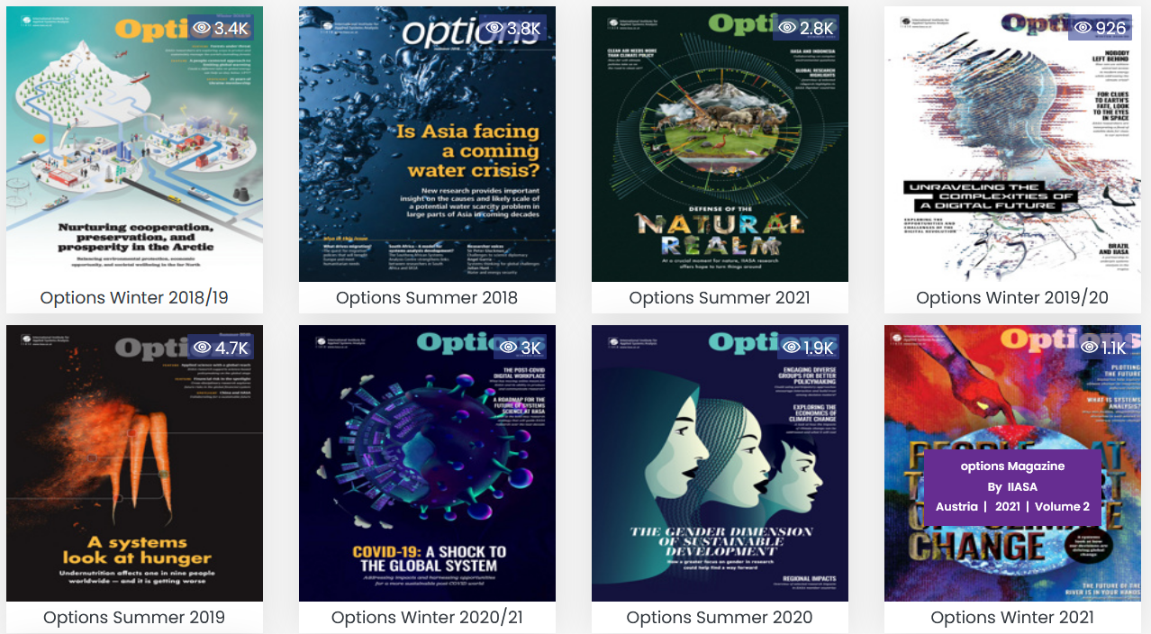
Searching e.g. for „IIASA“ we find at the moment 9 reports from IIASA, 8 are shown below. (IIASA stands for the internationally financed „International Institute for Applied System Analysis“ near Vienna). Notice that documents have been accessed quite frequently: The 4.7K on the left lower corner means it has been accessed already 4.700 times!
It is worthwhile to browse through the journals, since not only have they been read a lot, but many users left interesting annotations pointing to further material. And there are also interesting discussions .We will show an example a bit later.

Slide 27
Let us now turn attention to searches within a specific document.
NID documents are full text searchable, except if the font is e.g. an unusual one, or if the text is handwritten. In most systems, searching is restricted to plain text. In NID, OCR is even experimentally applied to text within pictures!
Annotations are added after a document has been made available as NID document, i.e. at a time when the index used for textual search is finished. The NID Team has started to even provide search within annotations. This is work in progress: when choosing search, use the option „annotation“ if you want to search within annotations.
Search is done based on a phrase as input. Places in documents where that phrase is found are shown. NID offers experimentally in addition to this a search for objects! I.e. it is possible to search for „person“ and every page containing the word person or an object of the type person is found! This is implemented only for a limited number of objects, since advanced AI techniques have to be applied to define the properties typical for a certain type of object.
In what follows there a few examples.

Slide 28
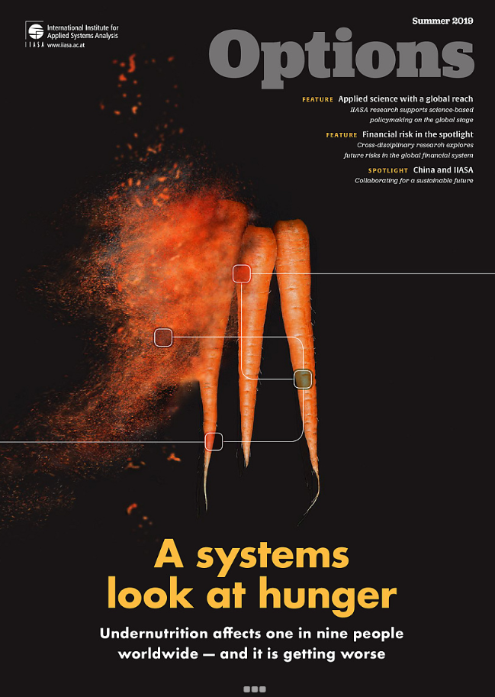
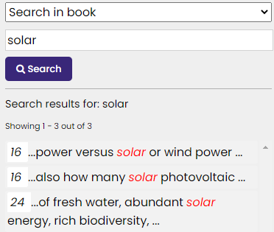
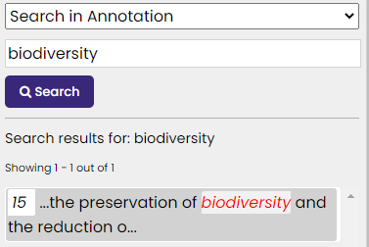
The search icon is a small looking-glass in the left upper corner. Clicking on it and searching for “solar” gives:
Thus, 3 pages in the issue contain the words “solar.” They show up on the pages surrounded by a broken red outline. Now, if before we search, we click at “Search in the book” we switch to “Search in annotation” and
type “biodiversity” the system comes up with:
Thus it does not directly point to the annotation containing the word, but to the page where one of the annotations contains it.
(Work in progress!)
This is the issue https://nid.iicm.tugraz.at/Home/ViewBook/127

Slide 29
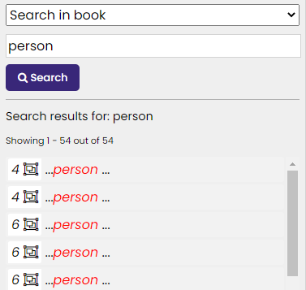
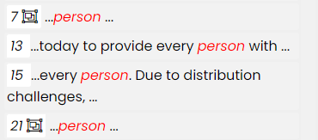
Next we show how „clever“ the system is in detecting objects (as mentioned, at them moment, a limited set. But could be expanded to fit a customer’s need). Using again the same search icon we type person. We get a long list. Only a part is shown below, starting as follows:
This time, the system has found two pages 13 and 15 containing the word “person” but quite a few with
the object person (as indicated by the icon )
In particular, it has found two objects “person” on page 4.
The next slide shows this page 4. NID hopes you are impressed.
This is the issue https://nid.iicm.tugraz.at/Home/ViewBook/127

Slide 30
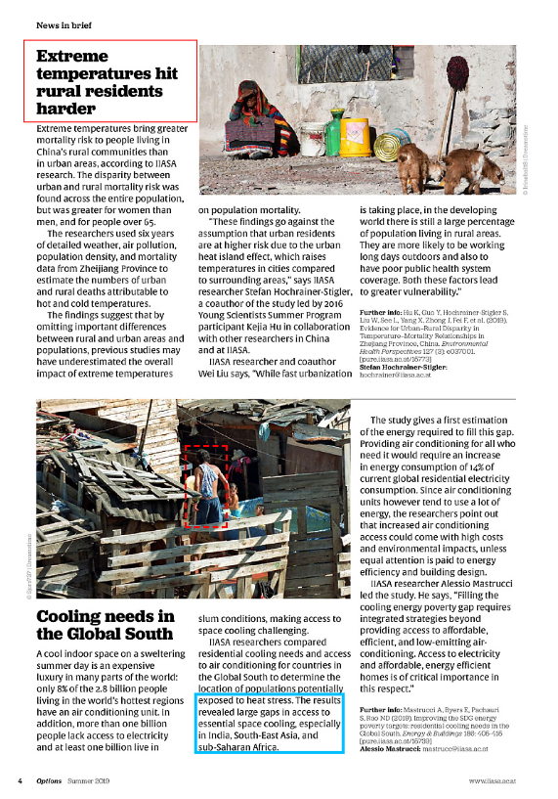
Is it not surprising that AI ( deep neural networks) are able to identify the heavily clad women in the upper picture and the man seen from the back in the lower pictures as humans, as “person”?
If you are interested in learning more about such object recognition look at Dr. Zaka’s document https://nid-library.com/Home/BookDetail/305
Let me take this opportunity to state very explicitly that the ideas of NID have been developed by me and Bilal ZAKA together, but the actual implementation and extensions were carried out by a team lead by the true genius ZAKA. We will continue our joint work on NID till at least end of 2023 to obtain a final product. However, it is already quite useable as is!

Slide 31
NID allows to define user-groups. Certain books, or certain annotations are only visible for persons belonging to a particular group. This can serve very different purposes as we explain with three examples.
Consider a complicated mathematical formula.
It may be shown as such to university students in mathematics.
But it must be shown with a short explanation to senior students in high school.
And it may be shown only with extensive explanations, including maybe links leading to still easier to understand material for less experienced persons.

Slide 32
Or consider an application for a car company. A picture of a new car is shown.
--- For the general population, annotations will explain some great features
--- For sales personnel, annotations might explain advantages over rival products
--- For engineers, annotations will give more detail on technicalities
--- For repair crews, annotations will give hints how to handle potential problems, those annotations getting longer as more incidents happen

Slide 33
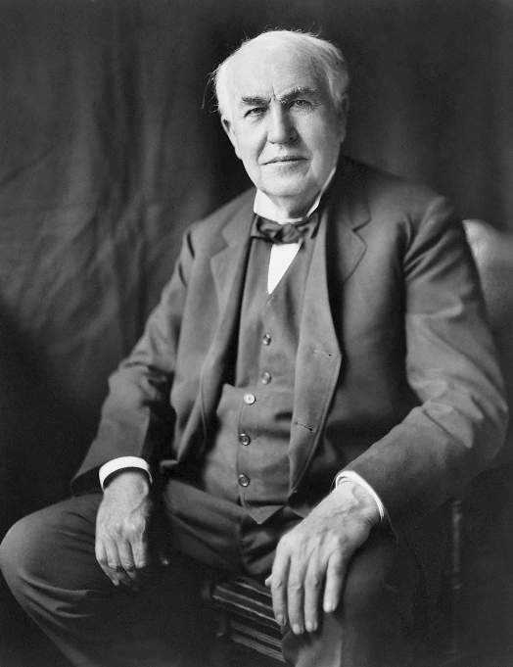
And here is yet another of the many application of annotations only visible to certain groups:
On the right is a picture of Edison. On the
next page you can see two pictures of him with different pictures added as annotations:
Different groups see different versions!

Slide 34
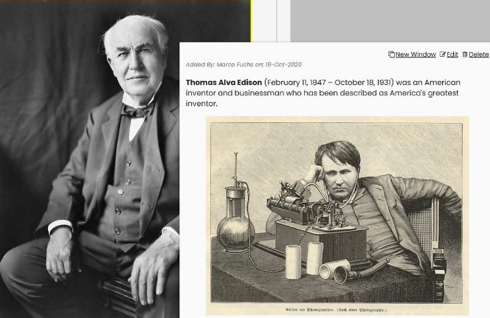
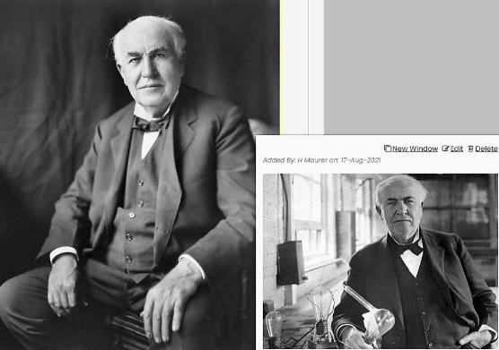
This annotation shows Edison with his famous phonograph,
for reasons unknown rather thoughtful or even unhappy.
This annotation also shows Edison in his lab, but this time in an elegant jacket.

Slide 35
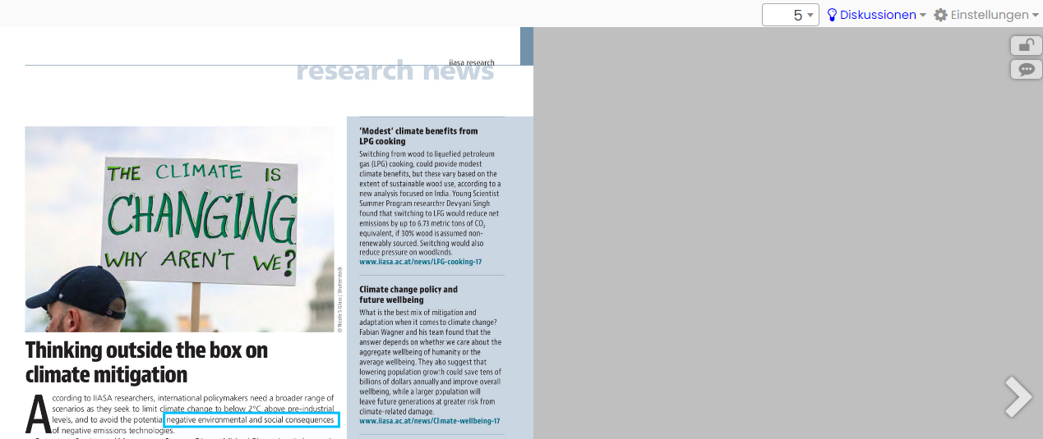
It was mentioned before that NID books allow discussions. Here is the right upper part of page 5 of a book. The fact that the word Diskussionen is lit up shows there is a discussion on this page.
Clicking at the word Diskussionen one gets a page (see next slide) where the gray part above is filled with the the initial part of a discussion.

Slide 36
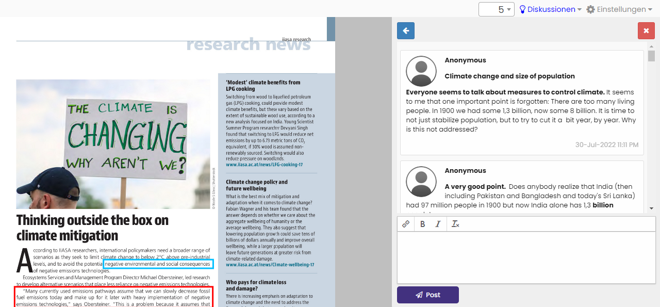
To see more, one has to scroll. To make following the discussion easier, it can be extended to the full page using the symbol, see next slide.

Slide 37
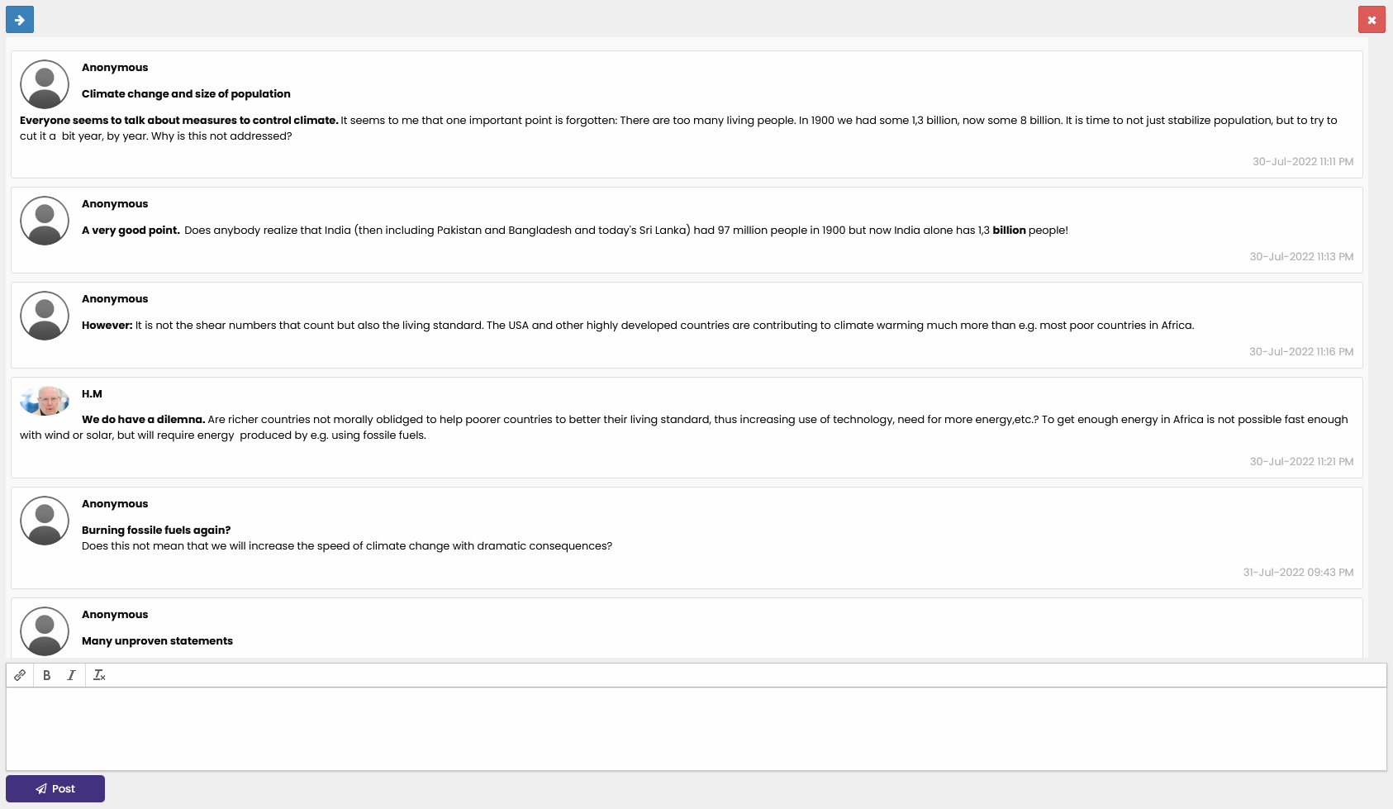
You still have to scroll to see the full discussion, but now it is easier to read. You can still post a contribution by typing in the open space at the bottom. By clicking at the arrow in left upper corner you can revert to the situation shown before.

Slide 38
NID has many other interesting features. I can just try to give an idea of further things possible using NID, referring otherwise to the ample literature on NID on https://austria-forum.org/af/AEIOU/NID or suggesting to contact me for info or a virtual meeting via hmaurer100@gmail.com.
One interesting feature of NID is that it allows to search for a phrase in a number of books at the same time.
Also, books may have a table of content added. In this case it can be used on any page of the book. We choose a book on Tesla:
https://nid-library.com/Home/ViewBook/172
To explain this and some other aspects, see first page of the book on the next page.

Slide 39
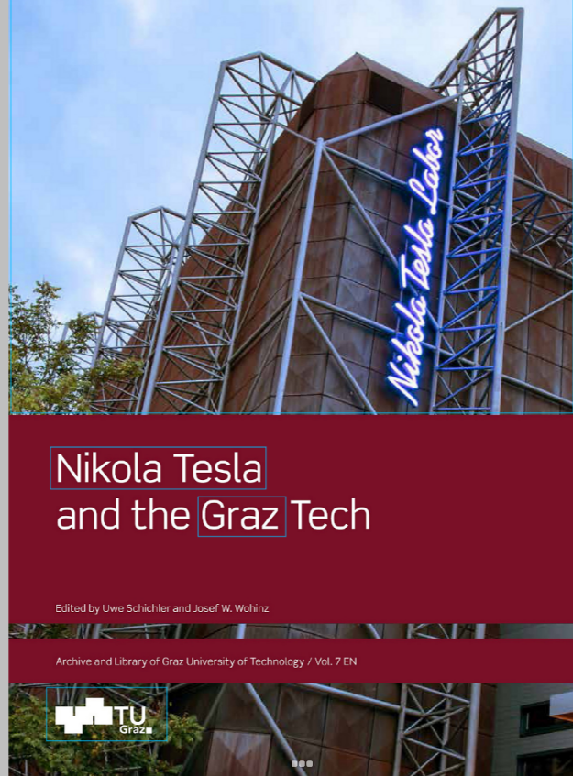
Notice the arrows < and > allowing to browse through the book; the icons at the right bottom corner allow zooming and shifting the current picture shown.
The icons in the upper right corner show the current page number (in this case:1). The option „Settings“allows the choice of interface language (e.g. English or German) and other options: When uploading the document, suitable starting choices can be made.
The closed lock means that the page is accessed anonymously. By logging in, the lock opens, and many more menu options become available. The icon for Feedback below the lock it has already been discussed earlier.

Slide 40
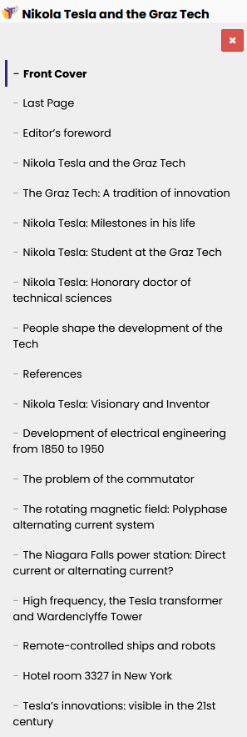
Now to the icons in the left upper corner:
The search icon has been discussed before. The first icon shows that this book has an automated table of
content. It will appear on each page. When clicked, the table of contents appears. The top part of the table is shown to the right.
Note the mark indicating the current place one is at.

Slide 41
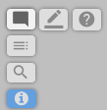
Note that the options beyond < and > are very limited, so that anonymous users are not confused by too many choices. If one logs in (after a one-time registration) the menus extend (or have been set to appear with more options when uploading the book also for anonymous users). The menu in the left upper corner looks then typically like this:
The pencil icon is particularly important and easy to use: it allows to add annotations at any place of the current page. The icon explains the very easy steps to create an annotation, so we skip the description here. The icon allows
to hide annotations, and with a double click to open the way for „Fancy annotations“, annotations that have a border-colour different from the ordinary blue, or a contour shape different from a rectangle. It is best to try this out: anyone making logged-in an annotation can change or delete it again afterwards, so you cannot ruin anything.
Actually, a special „Book for experiments“: https://nid-library.com/Home/BookDetail/220
is available where you can fool around at will, since once in a while I will clean it up again!
The ? icon allows to ask a question (sent to the author of the document) who will then hopefully answer it, see next page.

Slide 42
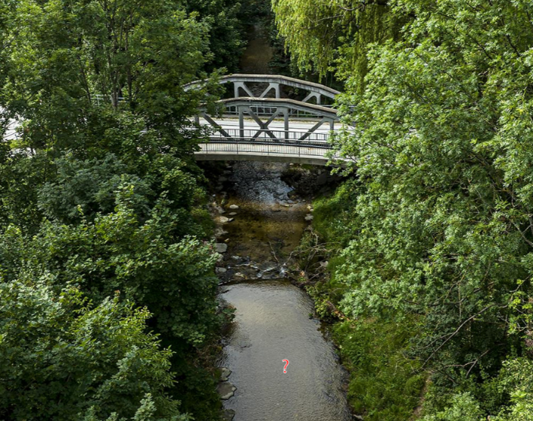
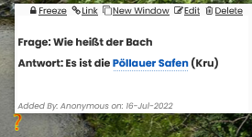
On page 28 of the beautiful document „Warum Pöllau?“ at https://nid.iicm.tugraz.at/Home/ViewBook/650
Someone just dragged the ? icon into the creek, typed a question ( „What is the name of the creek?“) and the authors of the book answered as you can see below:
The answer (Antwort in German ) was: „It is the „Pöllauer Safen“.
After discussion of the major menu items in the left upper corner as visible for logged in users we look at the right upper corner. Here one can e.g. select whether one wants just simple menu options for simple tasks, or more.

Slide 43
On the left you see the Short Menu with the option to switch to Full Menu, on the right you see the Full
Menu with options available via Settings. to the Short Menu.
„Discussions“ allows to start a discussion on the current page and check if there are any discussions ongoing in the document. If there is already a discussion on the page, the word is lit up as mentioned earlier to alert visitors.
Some of the Full Menu options are: „Change Layout“ allows to place more than one page on the same screen and work with them independently. E.g. English text on the left, German one on the right, see next slide.
„Settings“ provides language choice, group definition, quizzes and more. „Citation“ allows to automatically generate the correct citation according to a format of your choice for publishing. „Transclusion“ allows to create a link to part of a book-page, an unusual and powerful feature that can be used for anything much as graphic addresses are used for pictures.

Slide 44
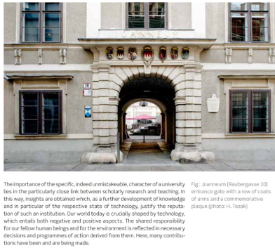
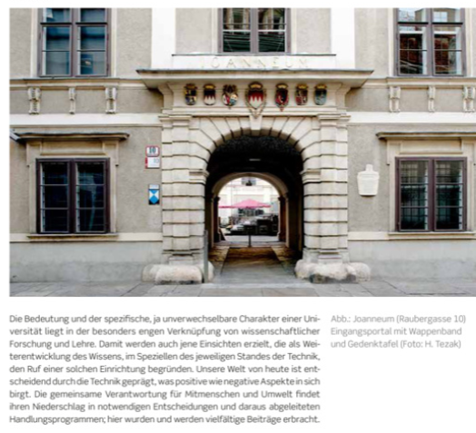
Two pages from two different books!

Slide 45
There are additional possibilities that are quite unique:
It has been mentioned that annotations of any type including links can be put into pictures--- in most systems e.g. links can only be added to textual objects. A typical example of using this feature of adding information in a picture is seen on the next page.
The system allows to load pictures with arbitrary resolution where one can zoom in maybe 50 fold or more. An example of a high-resolution picture of a city is shown on the next but one page, with a small blue spot. Zooming in on the blue spot it turns out to be a swimming pool, showing still waves of swimmers.

Slide 46
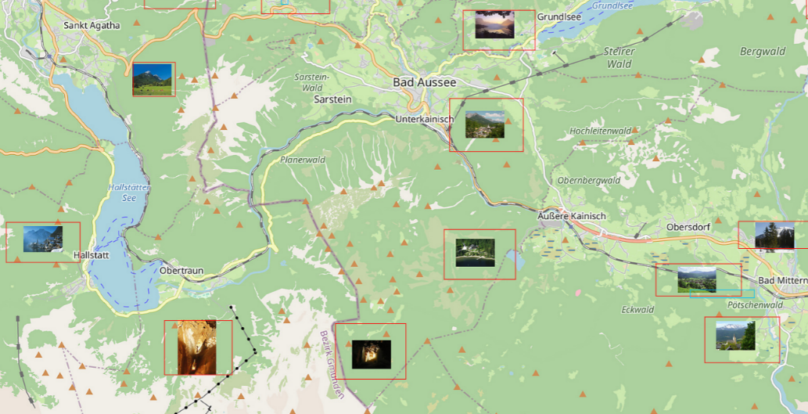
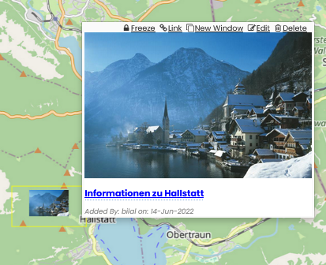
Part of the page
https://nid-library.com/Home/ViewBook/634
When clicking at the leftmost annotation (Hallstatt) in above picture, the picture of the place with a link to extensive information is made available

Slide 47
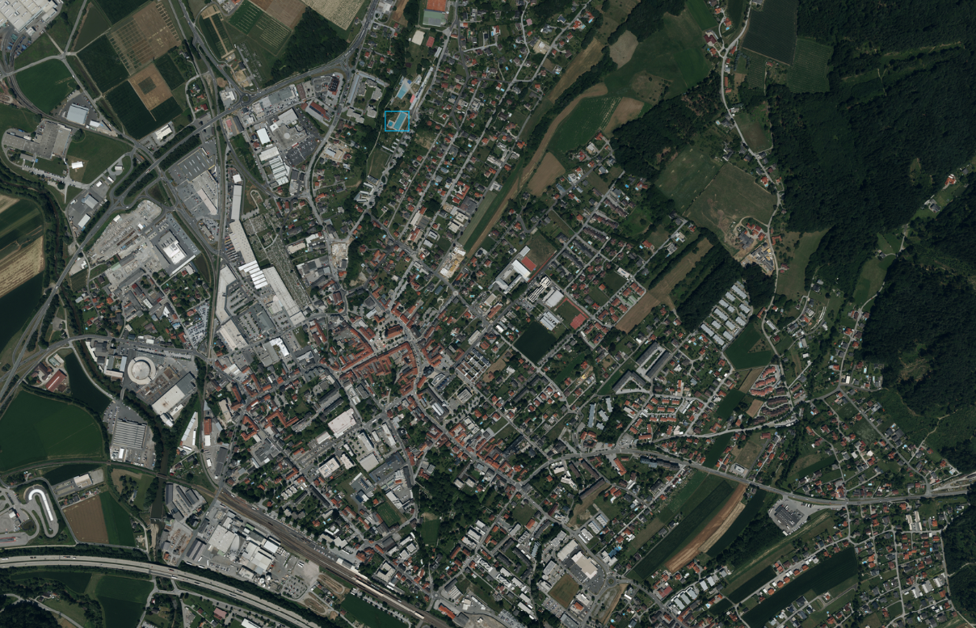
This is from page
https://www.nid-library.com/Home/ViewBook/411/33/view
Zooming in on the blue spot can be done to the extent that it covers the full page and is seen as a swimming pool, see next page!

Slide 48
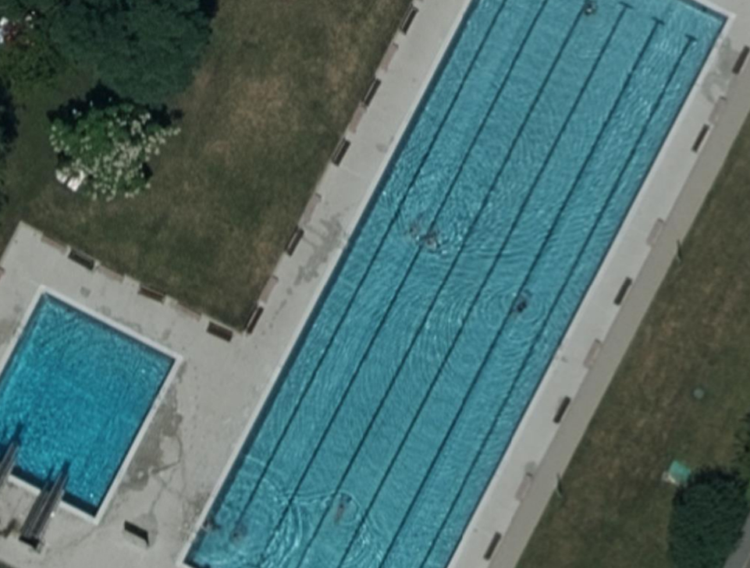
The blue spot was hardly recognizable as pool in the previous picture!
So we have now zoomed in by a factor of 40 or more!

Slide 49
Summary
I have explained some details of what NID can do. I have not at all covered all features, nor the powerful administrative tools to set up, and maintain a NID server, and all the functions and parameters one can choose when uploading a NID document.
If you are interested in trying out NID we offer you a subcategory on https://nid-library.com//Home/Collections/32. I.e. we make a computer, network, software and installation of documents available to you for possibly a token donation to the charitable organisation Austria-Forum.org You make documents available as Word-, PDF- or PPT-file. Of course we can also install NID on one of your computers, but we believe that you first should try it out!
Why don‘t you send me a message to hmaurer@iicm.edu to let me know if
(parts of) the presentation were interesting for you. If you want to do this anonymously, go to https://austria-forum.org/af/AEIOU/Kurzvideos_und_mehr and use the green Feedback button on the right. In any case thanks for your attention!
Prof. Dr. Hermann Maurer, hmaurer100@gmail.com

Slide 51
Life Demo of Austria-Forum and Net Interactive Documents (NID)
Hermann Maurer Graz U. of Technology Austria
Second presentation for the National Academy of Montenegro
February 2023 Podgorica

Slide 52
Here are some of the DEMOS shown life in this second talk. Austria-Forum: https://austria-forum.org Kunst und Kultur https://austria-forum.org/af/Kunst_und_Kultur : Symbole; Musik-Lexikon (show example); Heimatlexikon Video Alpengold: https://austria-forum.org/af/Heimatlexikon/Alpengold; Blogmobil Video: https://www.youtube.com/watch?v=etxPMWWxUG4 Start, then jump to 3:40 Essays: (In Kulturwandel durch Technik, Teil 3): https://austria-forum.org/af/Geography/Cross-country_information/Stability_of_digitized_information Allgemeinwissen: https://austria-forum.org/af/Allgemeinwissen/Geographie (Summary of relevant topics) Bilder: https://austria-forum.org/af/Bilder_und_Videos/Kronprinzenwerk (Choose a picture, e.g. in Dalmatien, Ragusa= Dubrovnik), then bookpage, then OCR) Suche nach Energie: https://austria-forum.org/af/AEIOU/Energie Geography: Montenegro: https://austria-forum.org/af/Geography/Europe/Montenegro (Choose pictures; and panoramas under special information; then maybe same for Croatia)
NID: https://nid-library.com
Montenegro: https://www.nid-library.com/Home/Collections/41 (Note interface-language can be switched to e.g. Serbian) Support of ordinary Webservers (e.g. https://austria-forum.org/af/Biographien/Fuchs,_Ernst_(geb_1851)
(see Link to NID Book!) IIASA: https://www.nid-library.com/Home/Collections/37 (Note frequency of access!) Conference Proceedings: https://www.nid-library.com/Home/Collections/31 Das grüne Juwel: https://www.nid-library.com/Home/BookDetail/243 (Look at one discussion) Touristic Information: https://www.nid-library.com/Home/BookDetail/857 (Try Suche in Annotationen, go to 200 page book)
Demo of annotation. Use Graphic address of a picture of Podgorica
Search in NID-Books „Hoamatland“, noting crossreferences to Austria-Forum, or „Mein Altausee“ as touristic application, etc.

