Slide 1
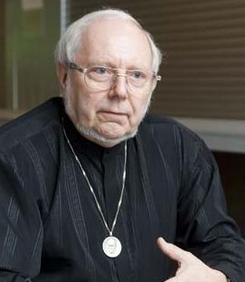
Documents Must Allow More Than Just Passive Reading
Hermann Maurer
Computer Science,
Graz University of Technology, Austria
Presentation May 29, 2025 at AAI2025, Serbia
I would love to switch a few times to a life demo, time does not allow this. But this document is sufficient that you can also try the ideas presented using Austria-Forum and NID and AI components yourself. This is why I am using much more text than is usual in presentations.

Slide 2
I will explain why „Documents Must Allow More Than Just Passive Reading “ by reporting the developments of sophisticated systems involving more and more AI.
Historically: We started with what was probably the first full encyclopaedia of any country available over Internet 1994.
We called it AEIOU (found on many old objects in Austria and often interpreted in Latin as: Austria Erit in Orbe
Ultima.) Our interpretation was: Austria Electronic Information – Online, Universally accessible). AEIOU is still
(slightly updated) available under https://austria-forum.org/af/AEIOU .
We started to systematically expand it content-wise to items outside Austria, but with a relation to Austria. And we also added more and more features going more and more beyond what Wikipedia has to offer. This better version is called Austria-Forum (AF for short): https://austria-forum.org and has been expanded by a new system NID (Net Interactive Documents) see e.g. https://www.nid-library.com/ and https://austria-forum.org/af/Neuigkeiten (with English Info on NID in second column). Basically developed by Dr. Bilal ZAKA and his group.

Slide 3
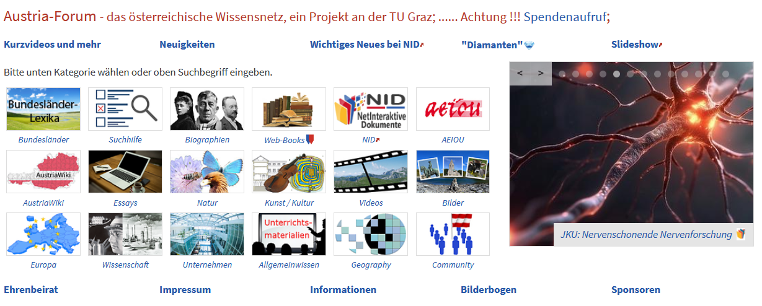

(1) Feedback button: Allows anonymous comments, or questions to be asked: This is a first step away from just passive reading, to some interaction. Immediate problems: Who can answer all questions? What if they are computer generated?
(2) Categories make searching more efficient
(3) Thousands of digitized books/documents provides much deeper information
(4) Fragen button activates our special Chat GPT system, to be discussed later
Let us now search in https://austria-forum.org in the category „Natur“ for the plant „Echter Seidelbast“ (English: Daphne).

Slide 4
What we find is a botanical description of the plant, a set of pictures, but most important two types of links at the bottom:
Weiterführendes
Die Giftgewächse der österreichischen Alpenländer (Link to a book)
Seidelbast in: Die Kräuter in meinem Garten (link to a book)
The first book is the only book that exists that describes all poisonous plants in the alps including how the poison acts, by giving several examples!
Austria-Forum Beiträge in ähnlichen Gebieten
https://austria-forum.org/af/Wissenssammlungen/Haus-_und_Gartenpflanzen/Seidelbast
https://austria-forum.org/af/Wissenssammlungen/Flora/Lorbeer-Seidelbast
Those links have been created by AI techniques as a first attempt to link related documents by AI. However, nobody in the world at this time knows how to do this satisfactorily since one needs „the semantic context“, impossible to find in million of large documents. Hence suggestions sometimes do not fit well or important ones are missing. Research is ongoing.

Slide 5
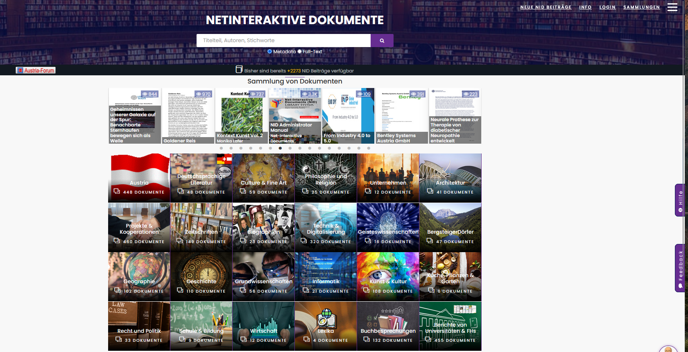

Entry page of our NID System. Items in the first row are rotating, showing new contributions.

Slide 6
Some main features of NID as explained later are:
-- Choice of language
-- Choice of complexity of menus
-- Interactivity in many forms, particularly „annotations“
-- Sophisticated search
-- Definition of user groups
NID features allow very different applications. Let us start by looking at https://www.nid-library.com/Home/BookDetail/127, an issue of a journal published by IIASA, an international institute based near Vienna. We find it under http://nid-library.com under „Zeitschriften“ and there under „Option Magazine“ on page 2 as the last entry. When we go to page 3, we find links that were added as „annotations“ at a later stage, < and > icons to go through pages, and a set of icons in left upper corner, right upper corner and right lower corner as discussed in what follows. Please look at page 3:

Slide 7
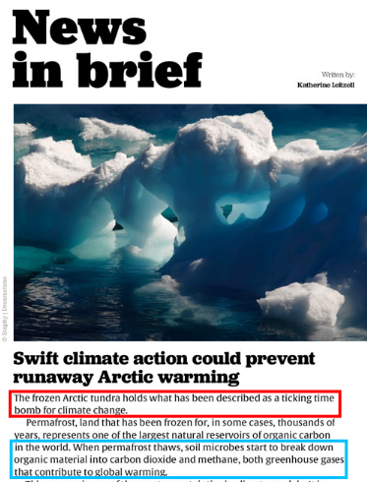

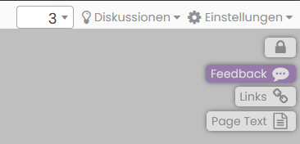

The pencil allows to make annotations (discussed later). The icon to the left makes all annoations invisible. The icon below is for a „floating“ ToC (table of contents) i.e. the ToC can be opened on any page. The looking glass below allows full text searching, but also searching for objects and more!)
Icons left upper corner
Discussions can be started or participated in. Einstellungen allows to change language and
the complexity of menus shown. Closed lock: One is anyonymous. Open lock: Means one has registered and has a number of
privileges, including belonging to a group that can see annotations and pages others cannot see.
Icons in right uper corner
Part of page 3 with links that
have been added later as „annotations“. Red leads to AF
contributions that also have a link back, blue leads to some other contributions (on other servers)
The icons in right lowerconer: To zoom and move current screen content

Slide 8


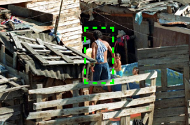
As mentioned before, the search function that is activated by clicking at
is very powerfull: it can do full-text search, search for objects (AI) , search many documents at the same time and more. Let us go once more to the document https://www.nid-library.com/Home/BookDetail/127 and turn to page one, then click at the search icon …… and type „person “ (without the quotes) where is says „Hier eingeben“ and start the search.
You get a long list of pages, where the system has found a person: like it shows ………………. indicating it has found the picture of a person on page 4. It has also found the word person e.g on page 13 and 15. Let us click at person behind page number 4. You get a page of the document. In the second picture shown on that page the system has found a person, and is showing it by surrounding it with a dashed green rectangle, see below.
It is impressive that it identifies this as a person, since only the back of a man is shown: The system has been trained with ten thousand of pictures, so AI can find out if there is a person independent of what part of a human body is shown! Ofcourse NID is relying here on work of other groups. At the moment NID can only recognize some 80 objects (person, bicycle, sofa, bottle, remote, kite, aeroplane, dog,….).

Slide 9
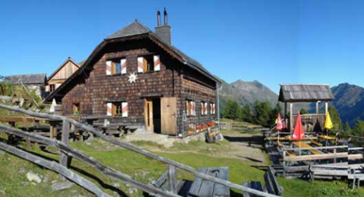
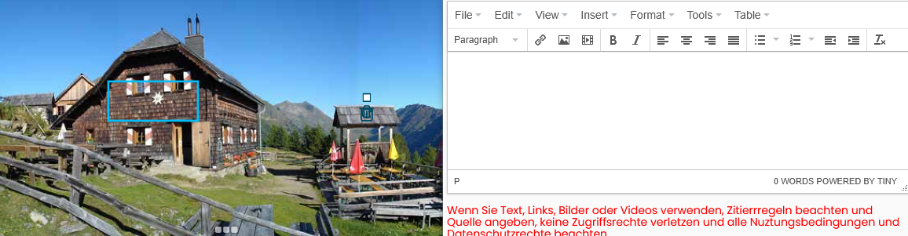
When clicking at the icon …. in the upper left corner you can draw in (the simple case) the blue outline of a rectangle anywhere on the current screen, typically over a part of text or or part of an image (here: Grazer Hüte, Krakau)where you want to add information or a link.
You can then add, using the form that appears as you draw the blue outline (see below) an „annotation“ (as we call it) i.e. any combination of text, links, images or mediaclips. Note this does not destroy the structure of the page!
To provide text, just type it in the form and store it. To add a link, use link icon and insert link and a short description, to add a media object chose the icon. Pictures can have arbitrarily large resolution!
Pictures, even if © protected can be used but one must not upload the picture but use its graphic address!!! This is as legal as any ordinary link.

Slide 10
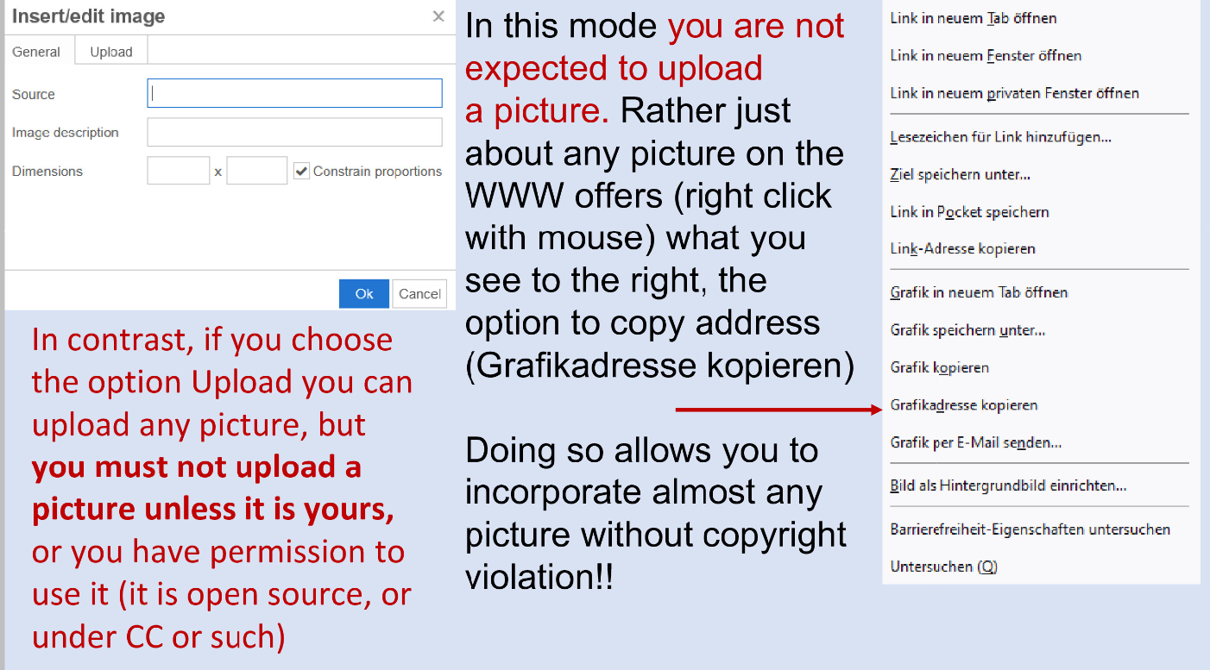

Slide 11
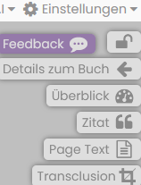
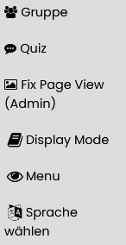
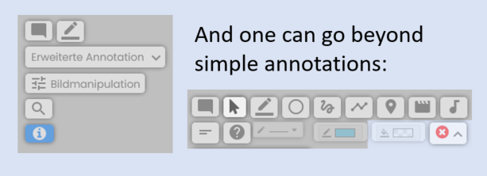
As was mentioned, the „Einstellungs“(„Settings“) Button allows to choose the language and also the complexity of the the menues. If I log in as editor I get the choices simple menue, half menue, full menue. If I choose full menue (Ganzes Menü) I get:
If I click Einstellungen now again:
There is no time to discuss all functions of NID. But notice e.g. there are discussion and quiz facilities, one can define groups
that have diffeerent views of documents (e.g. different annotations), layout can be changed a lot, etc.
But also the left upper corner menu changes:
More information under „NID Information (English)“ in the second column of https://austria-forum.org/af/Neuigkeiten

Slide 12
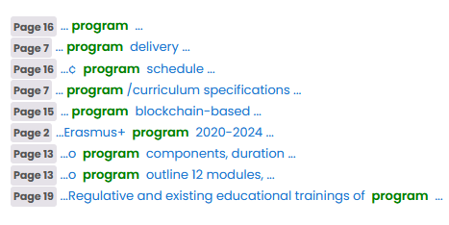
The NID document „Mein Altausee“ https://www.nid-library.com/Home/BookDetail/637 can be used to show that searching for annotation is possible. Try to use it for „wandern“ or „weg“ after selecting search for Annotation.
Searching is also possible not just in one document but in a set of them. Go e.g. to Eurospi 2023 https://www.nid-library.com/home/collections/135 select Full-Text, type „program“ in Searchfield, select Full-Text and click at the blue Search icon. It shows you now that many documents contain the word program somewhere. A click at the first (CHAISE) gets you:
NID allows to introduce groups. You can try this in the Tesla demo book https://www.nid-library.com/Home/BookDetail/187. Login as user „demotesla“ and password „sample“. Start reading the book. With the button „Einstellungen“ select „Full-Menu“, and now click again at „Einstellungen“. Now click at „Group“. Try “Public”, later “red” or “green” and see difference.
This shows all the spots in the document CHAISE where the word program occurs.

Slide 13
--- Categories can have Table of Contents. Look at Bergsteigerdörfer or Buchbesprechungen in the list of Categories on NID Main page https://www.nid-library.com/, and note how back and forth links are used for each of the villages in Bergsteigerdörfer
--- Check some of specially recommended items on Neuigkeiten https://austria-forum.org/af/Neuigkeiten
--- Discussions are possible, search homepage of NID for Türkenschanzpark (see e.g. https://www.nid-library.com/Home/ViewBook/243/20/view ). To see all contributions to discussions do not forget to scroll down!
--- I have skipped all administrative features. How to upload with various parameters ( © , visibility, modify documents and categories in many ways, Wiki-type information can be added to categories and so-called “Sammlungen” (collections). For some issues discussed before but also other aspects see the presentation https://www.nid-library.com/Home/ViewBook/1529 or search for “NID” on Austria-Forum Homepage https://austria-forum.org/ and browse in some documents. For a German document see https://www.nidlibrary.com/Home/ViewBook/2469 .

Slide 14
Let us now repeat and discuss AI features in Austria-Forum
--- Topics shown for each book extracted by AI (mentioned earlier)
--- Links to interesting other contributions are generated below each contribution (aim is to point to semantically similar contributions, but this is still an unsolved problem, on which many groups are working world-wide)
--- Search for objects (was shown with example “person”)
--- NID has own ChatGPT system with special properties we will explain next
--- Finally click on any Austria-Forum page on the “Fragen” Button on the right side to try out NID GPT , as we will show a the end with three examples

Slide 15
Special features of the Austria-Forum NID GPT (some not completely implemented yet)
--- Allows questions in most European languages and gives answers in the language of the question
--- It uses only material of Austria-Forum. BUT:
--- Ofcourse it can be used also on other servers, not just Austria-Forum servers and (very powerfull!) allows administators to include parts of other WWW material to be used for generating answers if desired. I.e. the quality of answers (or more accurately: where they come from) is clear.
--- Answers can provide links (if desired) and automatically point to related material

Slide 16
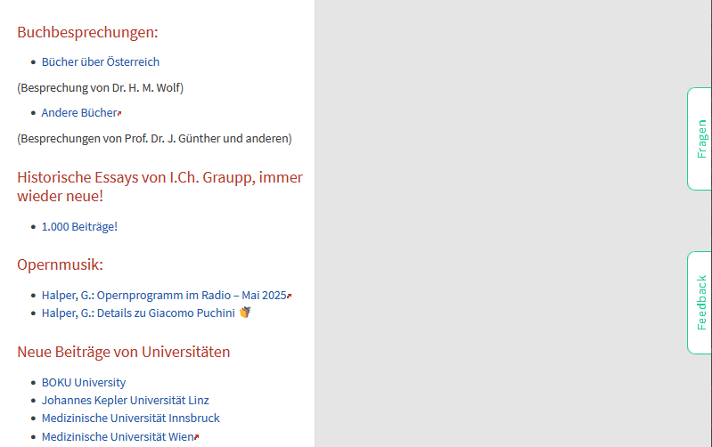
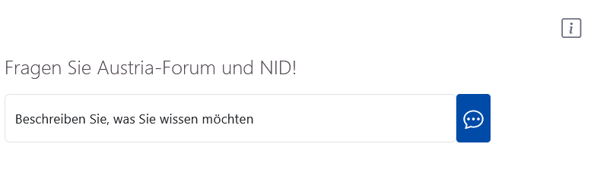
You activate NID GPT by clicking on any page of AF the button: Fragen
By clicking here you get what you see below
Type here what you want to know in any language

Slide 17
NID GPT answers to the question:
Please give me information on attractions and experiences available on the city of Graz:
The city of Graz offers a diverse range of attractions and experiences. One of the most notable aspects of Graz is its rich cultural heritage, which is reflected in its well-preserved historic center. The historic center of Graz has been designated as a UNESCO World Heritage Site since 1999, due to its unique blend of Gothic, Renaissance, and Baroque architectural styles. In addition to its rich cultural heritage, Graz also offers a wide range of modern attractions and activities. The city's vibrant arts scene is reflected in the numerous galleries, museums, and performance venues that can be found throughout the city. Some examples of these modern attractions include: * The Kindermuseum Graz, a unique museum dedicated to children's education and entertainment. * The City of Design designation, which recognizes Graz as one of the world's leading cities for design innovation and creativity. * The Steirischer Herbst festival, a renowned international arts festival that takes place every autumn in Graz. In summary, the city of Graz offers a unique blend of traditional cultural heritage and modern attractions and activities.
[Response time (hh:mm:ss): 00:00:07]
Andere interessante Artikel
https://austria-forum.org/af/AEIOU/Kindermuseum_Graz
https://austria-forum.org/af/AEIOU/Graz_Burg
https://austria-forum.org/af/Wissenssammlungen/Historische_Bilder/Themenbereiche/Schlösser_Burgen_Klöster/Graz
https://austria-forum.org/af/AEIOU/Graz_Rathaus_Architektur

Slide 18
This what you might get you might get !
The system may well give different answers if you ask the same question. Questions may be asked in any major European language, and will be answered in that language. NOTE: The system is still under development
When using the GPT, questions should be very specific. If you ask “Please give me information on turkey” you might get very surprising results. The system does not know if you are asking for the animal or the country or a restaurant with that name, etc. So please formulate your questions with lots of clarifying information.
So you better ask for “animal turkey”, “country turkey”, “restaurant with name turkey” etc.

Slide 19
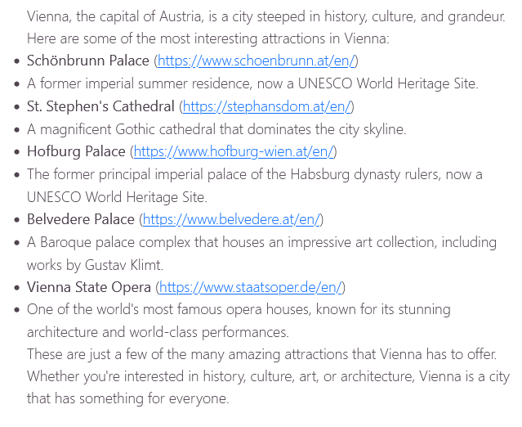
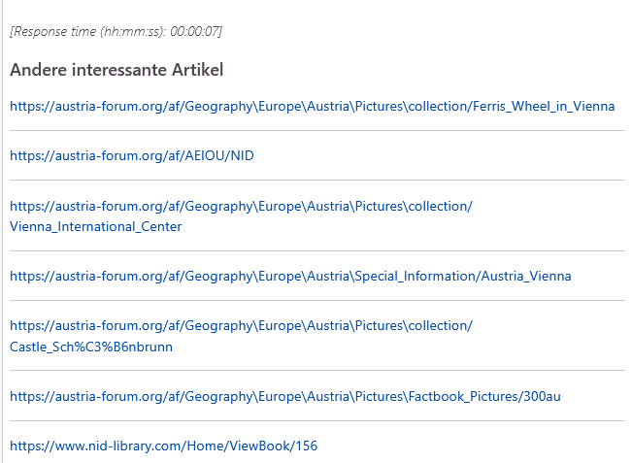
Asking the question:
Give me some interesting attractions in the city of Vienna, please with links
And here below it shows in addition further links to AF:

Slide 20
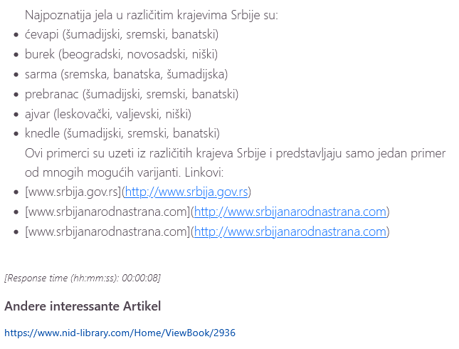
If you ask the question:
Koja su najpoznatija jela u različitim krajevima Srbije? Molim te navedi primere sa linkovima
And this is actually a book in Serbian language on food in Serbia

Slide 21
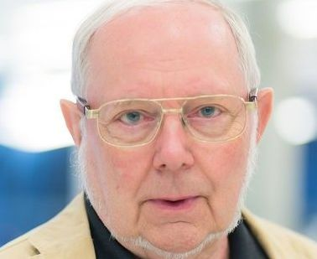
Thank you for your attention!
hmaurer100@gmail.com
You can find my full PPT presentation that I showed you by using the Search field (Suche) on almost any page of Austria-Forum.org by searching for AAI2025 . Feel free to copy it , I make it available for public domain.
Note: The book https://www.nid-library.com/Home/ViewBook/220 has been added for users to try out any features
of NID they are interested in …. one cannot destroy anything by what one is doing!!

