Slide 1

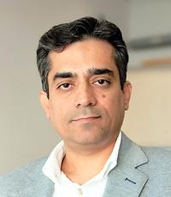
Dr. Hermann Maurer
Professor Emeritus for Computer Science, Graz University of Technology, Austria
The work to be reported is done jointly with Dr. Bilal Zaka from COMSATS University in Islamabad, Pakistan. He is also the first author of our paper.
Official title of my talk:
COMBATING POLARIZATION THROUGH CREDIBLE INFORMATION EXCHANGE: A TRUST-CENTERED SOCIAL MEDIA ARCHITECTURE
But maybe ATSNET – A Trustworthy Social NETwork is easier to understand

Slide 2
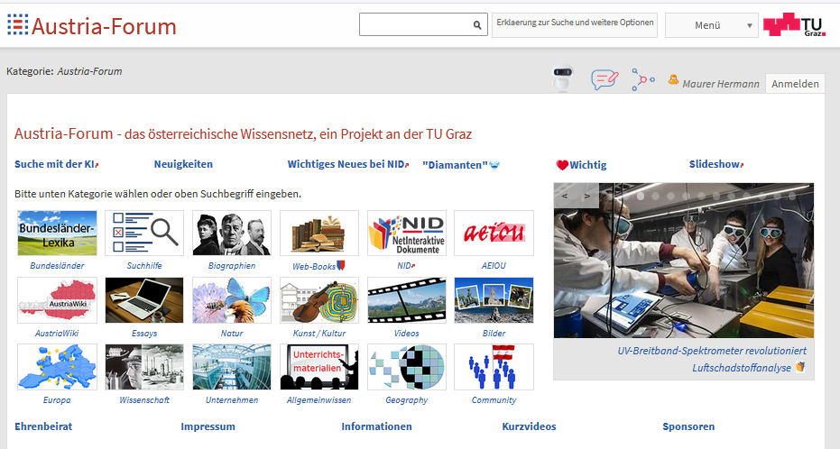
ATSNET – A Trustworthy Social NETwork as answer to all social networks full of fake information
It all started with an attempt
to provide trustworth
information, more tightly
controlled than in Wikipedia.
It was called Austria-Forum
with 300+ experts as Editors
1503068 Objekte in dieser Kategorie
5778 Digitale Bücher

Slide 3
However, even 300 editors (experts in different areas) were not enough to guarantee that all would be of the quality desired.
It was clear that further measures would be needed.
This lead to the concept of NID (Net Interactive Documents) where information was basically only uploaded by experts when they had approved it. And users were allowed to provide information by sending feedback or even making „annotations“ in existing contributions.
But the annotation mechanism would allow that annotations would only be visible immediately when made by experts, or after an experts approved them.

Slide 4

Again, information is categorized with subcategories and sub-sub categories to have only experts in the area of the category looking at contributions
Many new features, like full-text search, search for pictures (AI!), feed-back possibility, increasing number of AI features (for every contribution a summary is created using AI), every reader can make annotations.
The critical feature: Contributions can only be made by category editors and annotations to a contribution can be made by anyone, but with a possible restriction: they are made first visible only to category editors: They decide if they should be visible to the public !

Slide 5
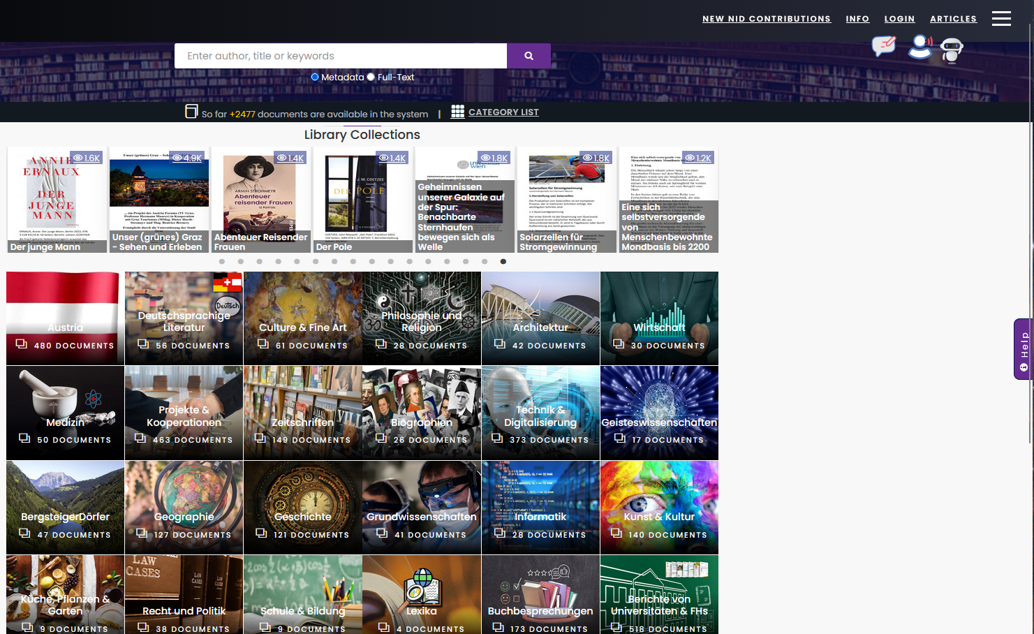
Button for feeback
Button for speech
input and
output
Button for special chatbot with
access to aproved
content an tryign to avoid halluciantions
Now let us look at the right upper part in a bit more detail.

Slide 6

Clicking at ARTICLES (German: Sammlungen) leads to many contributions, often new ones, that can be NID or ordinary Web pages.
Clicking at provides alternatives when looking at NID contributions, like choice of language, the menue when looking at NID pages. The next slide shows that the option „full menu“ was chosen when looking at a book on Serbia.

Slide 7
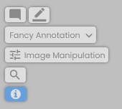
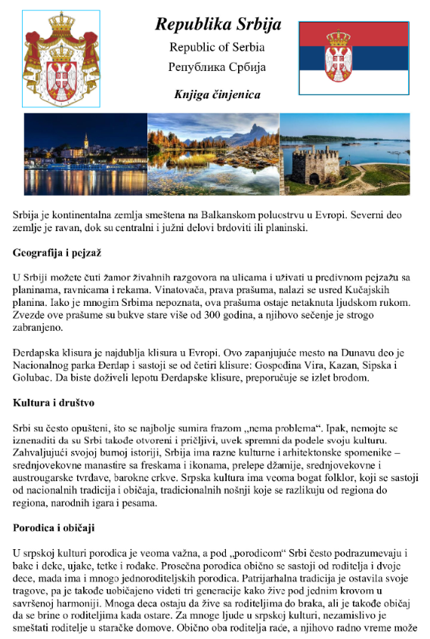
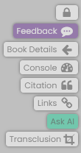



Slide 8
NID does provide quality and no fakes. However, it is hard to find enough reliable category editors. Also, a NID system has to be fed with contributions. It is clear that if an organization installs NID it wants to automatically include parts of their data-base.
To improve this we have designed software for ATSNET servers and made precautions (that with few expert editors) quality can be controlled. We do this by heavily using AI.
At typical ATSNET server is not for chats, but for discussions of a selected number of topics. In that sense maybe it should not be called a trustworthy social net but rather a trustworthy discussion net. Typically, if someoneone sets up a such server, it is dedicated to just some topics. One server might deal with e.g. Energy, Climate, Democracy an other one maybe e.g. with Cars, Fuels, Mobilty, etc.
Anyone can send an email with a contribution (including links to relevant contributions on the Web) to the server, but has to (a) chose one of the allowed topics, (b) send some (arbitrarily chosen) name and (c ) the real name and if possible a pointer to a CV or such.
All visitors of the site can only see the contribution and the chosen name but only if the editors associated with the site approve the contribution. All other informations from the sender remains confidential).
So how can AI help to make sure (help the editors) to decide if the information provided is correct?

Slide 9
AI tries to determine if the real name given it indeed correct, if necessary by emailing submitter or even organizing a virtual meeting. AI can thus dedect previous work (and check its reliabiliy) , age of submitter, and area of expertise of submitter. This provides a „contributor ranking“ for the editors.
AI compares the contribution and links with contributions concerning the same topic on „quality sites“ and approved contributions of the same contributor. This provides a „contribution ranking“ for the editors.
Based on „contributor ranking“ and „contribution ranking“ and their own expertise the contribution is accepted and made public, or is rejected, or sent back to a special AI module for „further investigation concerning…“

Slide 10
We have developed or sketched the development of some 50 different AI modules and do not intend to reveal all information on them. We will make the system software available to any organization interested when finnished, but some details we are hiding on purpose „for digital souvereinity“ reasons. Thus, not all ideas can be copied easily.
I have to apologize that this is also the reason why I do not want to dicuss further details to any extent. And I am happy that I was given only 20 minutes time for my presentation to just give you a first impression.
Thank you for the invitiation to participate in this AAI Serbia 2026 great event, and for listening to me.
Professor Dr. Hermann Maurer, hmaurer100@gmail.com

