Slide 1
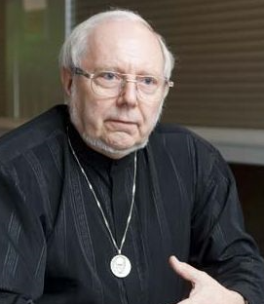
Advances in IT should be used to change how digital libraries are used
Hermann Maurer Computer Science,
Graz University of Technology
November 16, 2024
Note: My presentation will switch many times to a life demo, yet this document should be sufficient that you can also try the systems Austria-Forum and NID life yourself.

Slide 2
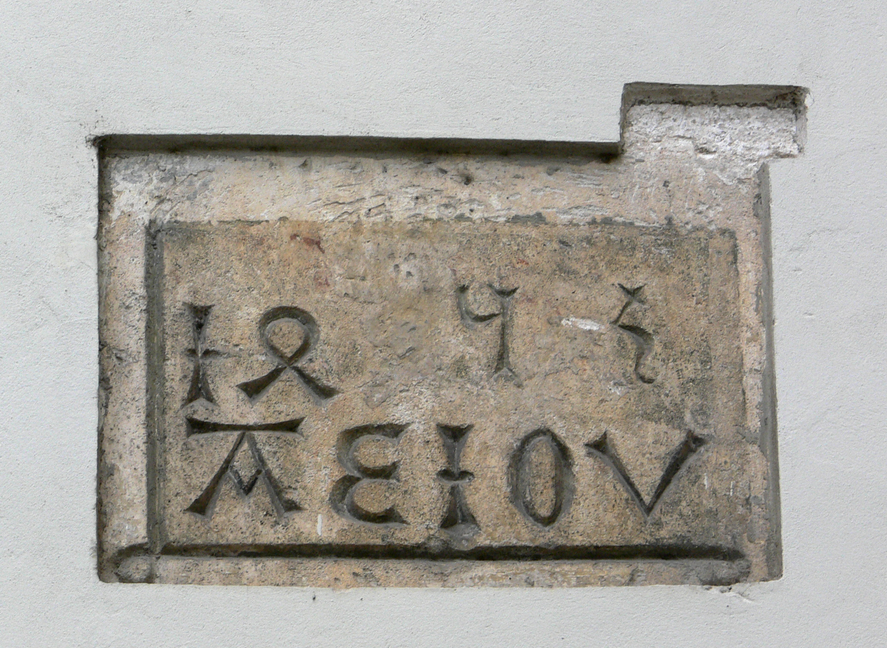
I will explain why „Advances in IT should change how digital libraries are used“ by reporting the developments of a Web server to a sophisticated system involving more and more AI.
We started with what was probably the first full encyclopaedia of any country available over Internet 1994. We called it AEIOU (found on many old objects in Austria and often interpreted in Latin as Austria Erit in Orbe Ultima.)
Our interpretation was: Austria Electronic Information- Online Universally accessible). AEIOU is still (slightly updated) available
under https://austria-forum.org/af/AEIOU .
Foto: Andreas Praefcke,Wikicommons
We started to systematically expand it content-wise to items outside Austria, but with a relation to Austria. And we also added three technical items: (1) A feedback button ; (2) Grouping things in categories; (3) Adding electronic books. This better version is called Austria-Forum: https://austria-forum.org

Slide 3
(1) Feedback button: Allows anonymous comments to the server administration, or questions to be asked: This a first step away from just passive reading, to some interaction, but immediately poses problems: Who can answer all questions? What if they are computer generated?
(2) Categories make searching more efficient
(3) Digital books can provide much deeper information
Let us now search in https://austria-forum.org in the category „Natur“for the plant „Echter Seidelbast“ (English: Daphne).

Slide 4
Notice that we found a Wikipedia-kind of description of the plant, but then much more:
A pointer to a segment in an old digitized book on poisonous plants in the the Alps, and even help for persons who cannot read old print!
And at the very bottom: AI generated links.
Clearly, more functionalities were desirable. We have bundled them into a system NID (Net Interactive Documents) that can co-live with any existing Wiki, including ofcourse the one used for Austria-Forum. Austria-Forum homepage of NID: https://nid-library.com

Slide 5
Some main features of NID are:
-- Choice of language
-- Choice of complexity of menus
-- Interactivity in many forms, particularly „annotations“ -- Sophisticated search -- Definition of user groups
NID is also used by others, like Dr. Camhys institute https://nid.kinderphilosophie.at/ and many basic features of NID were already described last year, see my presentation https://nid.kinderphilosophie.at/Home/Collections/44. So there is some repetition today.
NID features allow very different of applications. Let us start by looking at https://www.nid-library.com/Home/BookDetail/127, an issue of a journal published by IIASA, an international institute based near Vienna. We find it under
http://nid-library.com under „Zeitschriften“ and there under „option Magazine“ on page 2 as the last entry.

Slide 6
Important issue that have been be shown using this book:
When getting the first cover of the book (journal): -- Change Language using the icon right upper corner:
Right side top menu: Right side downward menu for Help and Feedback -- New NID Contributions -- Info
-- Login -- Articles
Left bottom menu:
--Get document topics with icon:
--Possibility to leave review

Slide 7
When reading in book:
--Cover page with two annotations (have been created after uploading the book) -- Button for forward > and back <
--Icon for logging in: --Icon for message:
-- With language choice and type of menu and display options
-- Icons for changing size and position (right lower corner)
--Icon for floating table of contents: --Icon for searching (full text & object): --Icon for logging in: --Icon for message:

Slide 8
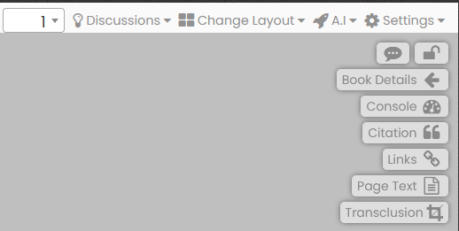
After Login
Possible change of menues. When hmaurer logs in the right upper-corner menues are:
From left: One can go to any page; one can check if there are discussions; layout can be changed; Settings allows change of menu; meaning of others not fully discussed

Slide 9
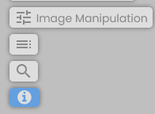
When hmaurer logs in the left upper-corner menus are:
Used to hide all annotations on a page. (You have to be in Half of Ful Menu to see this icon!). Try this with page 2 in the book „Grünes Graz“: https://www.nid-library.com/Home/ViewBook/857/2/view
This is an important icon: Clicking at it allows to make an annotation (see next frame). Unless Fancy Annotation is selected the blue outline of a rectangle can be drawn anywhere on the screen.
Only necessary if annotation shape or colour shoud be different from thin bluish outline of a rectangle as shown on cover page of the journal we looked at
Try it
Discussed before: Floating ToC
Discussed before: Search
Some possibley helpful inforamtion

Slide 10
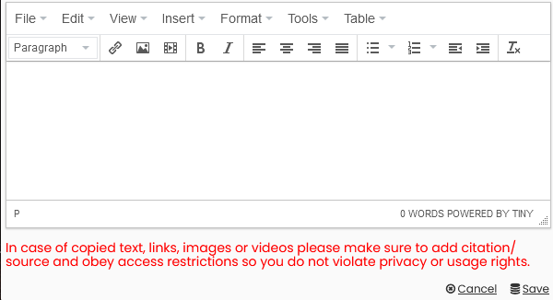
When clicking at the following form appears, allowing to add as annotation any combination of text (just type it), links, images or mediaclips
Note: Pictures, even if © protected are possible as annotations, even in pictures. Pictures can have arbitrarily large resolution! For copyright protected pictures click at the picture with right mouse button to get graphic address of picture and use this on. This is as legal as any ordinary link, i.e. not permitted if it could be against the interest of the owner of the site with the picture.
Maybe a look at this page helps a bit: https://www.nid-library.com/Home/ViewBook/1529/18/view

Slide 11
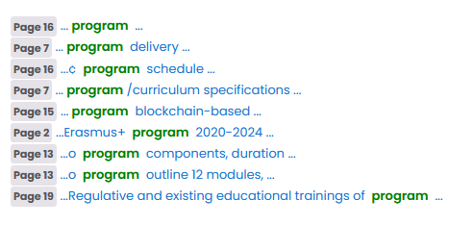
The NID document „Mein Altausee“ https://www.nid-library.com/Home/BookDetail/637 can be used to show that searching for annotation is possible. Try to use it for „wandern“ or „weg“ after selecting search for Annotation.
Searching is also possible not just in once document but in a set of them. Go e.g. to Eurospi 2023 https://www.nid-library.com/home/collections/135 select Full-Text, type „program“ in Searchfield and click at the blue Search icon.
It shows you now that many documents contain the word program somewhere. A click at the first (CHAISE) gets you:
Showing you all the spots in this document where the word program occurs.
NID allows to introduce groups. You can try this in the Tesla demo book https://www.nid-library.com/Home/BookDetail/187
Login as user „demotesla“ and password „sample“. With the buttons select „Full-Menu“, and now with the same buttons pick „Group“. Try “Public”, later “red” or “green”.

Slide 12
--Categories can have Table of Contents. Look at Bergsteigerdörfer or Buchbesprechungen in the list of Categories on NID Main page https://www.nid-library.com/, and note how back and forth links are used for each of the villages in Bergsteigerdörfer
--Check some of specially recommended items on Neuigkeiten https://austria-forum.org/af/Neuigkeiten including manuals and the presentation under “NID Information”
--Discussions are possible, search homepage of NID for Türkenschanzpark (see e.g. https://www.nid-library.com/Home/ViewBook/243/20/view ). To see all contributions to discussions do not forget to scroll down!
--Applications for organizing information for every organization (helpful: different infos for different groups!), for learning, for advertising (e.g. books, organizations).
For some issues discussed before but also other aspects see the presentation https://www.nid-library.com/Home/ViewBook/1529 or search for “NID” on Austria-Forum Homepage https://austria-forum.org/ and browse in some documents. For a German document see https://www.nid-library.com/Home/ViewBook/2469 .

Slide 13
Addition of AI features in 2024
--Topics shown for each book extracted by AI (mentioned earlier)
--Links to interesting other contributions are generated below each contribution (aim is to point to semantically similar contributions, but this is still an unsolved problem, on which many groups are working world-wide)
-- NID has own ChatGPT system. Click on any Austria-Forum page on the green “Fragen” Button on the right side. On the form appearing type e.g. the question:
“What is particularly interesting in the city of Graz?”
You might get as answer what is shown on next slide:

Slide 14
The city of Graz offers a diverse range of attractions and experiences. One of the most notable aspects of Graz is its rich cultural heritage, which is reflected in its well-preserved historic center. The historic center of Graz has been designated as a UNESCO World Heritage Site since 1999, due to its unique blend of Gothic, Renaissance, and Baroque architectural styles. In addition to its rich cultural heritage, Graz also offers a wide range of modern attractions and activities. The city's vibrant arts scene is reflected in the numerous galleries, museums, and performance venues that can be found throughout the city. Some examples of these modern attractions include: * The Kindermuseum Graz, a unique museum dedicated to children's education and entertainment. * The City of Design designation, which recognizes Graz as one of the world's leading cities for design innovation and creativity. * The Steirischer Herbst festival, a renowned international arts festival that takes place every autumn in Graz. In summary, the city of Graz offers a unique blend of traditional cultural heritage and modern attractions and activities. [Response time (hh:mm:ss): 00:00:07] Andere interessante Artikel https://austria-forum.org/af/AEIOU/Kindermuseum_Graz https://austria-forum.org/af/AEIOU/Graz_Burg https://austria-forum.org/af/Wissenssammlungen/Historische_Bilder/Themenbereiche/Schlösser_Burgen_Klöster/Graz https://austria-forum.org/af/AEIOU/Graz_Rathaus_Architektur

Slide 15
You might get !
The AI system may well give different answers if you ask the same question. Questions may be asked in any major European language, and will be answered in that language.
NOTE: The system is still under development. It only uses material from Austria-Forum and NID, and at the moment not all of it. The fact that any user installing NID (it always comes with a Wiki) and using its GPT system gets only information form the server is possibly important for organizations.
When using the GPT, questions should be very specific. If you ask “Bitte um Informationen über Adler” you might get very surprising results. The system does not know if you are asking for a person with name Adler (there are a number of persons Adler: Victor Adler, Alfred Adler), or about the bird Adler (eagle), or one of the companies named Adler, etc.
So you better ask for “Vogel Adler”, “Person Victor Adler”, “Firma mit Namen Adler” etc.
Thank you for your attention! Please browse the pages https://austria-forum.org/ and https://www.nid-library.com/ once in a while for news! This presentation can also be found on https://austria-forum.org/af/User/Maurer%20Hermann/Maurer-24-11-16

