Slide 1
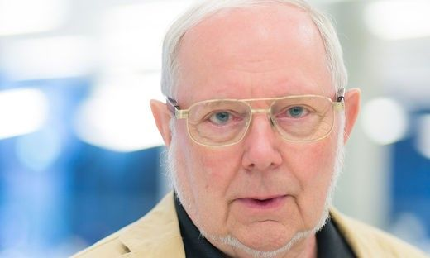
Libraries of Interactive Books as Powerful Tool for Information Communication
Presenter and Co-author: Hermann Maurer, Graz University of Technology, Graz, Austria
Other authors: Namik Delilovic, Graz University of Technology, Graz, Austria Bilal Zaka, COMSATS, Islamabad, Pakistan
Presentation at ED-MEDIA 2019, Amsterdam, June 25, 2019

Slide 2
Many types of digitized books exist today:
--- As PDF file
--- In e-Pub format
--- For Kindle
--- In many other formats

Slide 3
Many types of digitized books exist today:
--- As PDF
--- In e-Pub format
--- For Kindle
--- In many other formats
Typical adavantages of digitized books vs. printed books:
--- Easier to carry
--- Change of fonts, choice of brightness
--- Bookmarks
--- Start of reading where one stopped
--- Most allow full-text search and/or other searches --- Some allow notes
--- …

Slide 4
However:
--- Often limitd freedom for manipulating pictures or text
--- They do not allow media beyond text, tables and pictures

Slide 5
However:
Not all allow good presentation and/or zooming of pictures
They do not allow media beyond text, tables and pictures
Why not allow:
--- video or audio clips
--- 3D objects/ scenes --- quizzes or multiple choice tests
--- interactive applications
--- links or even transclusions

Slide 6
We are no the only ones who think so! Come to the keynote tomorrow:

Slide 7
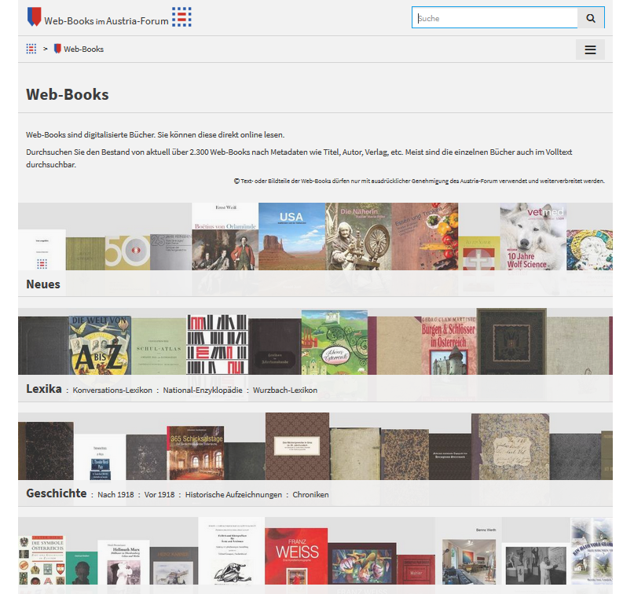
Our effort in Graz:
By now over 2.300 „interactive books“
with many interactive
possibilities, and more
to come…
Now a few examples

Slide 8
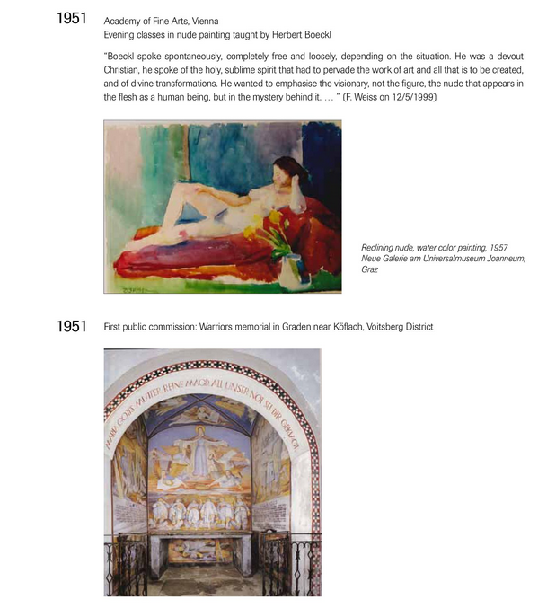
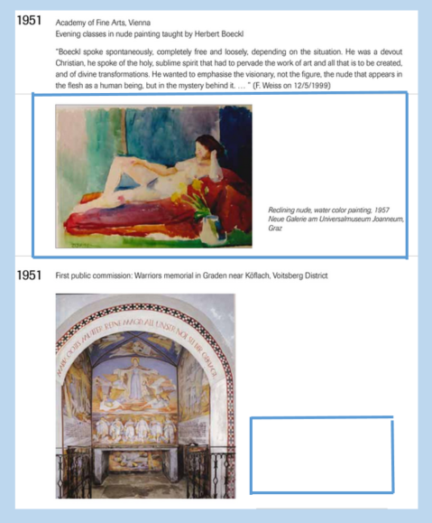

Slide 9
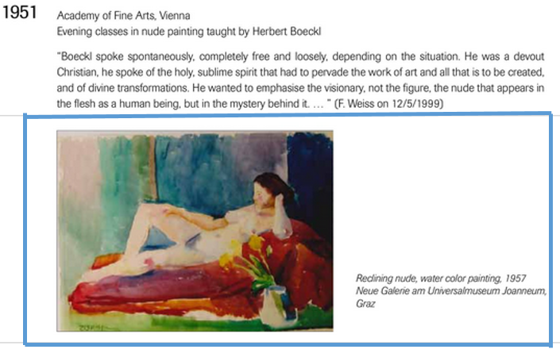

Slide 10
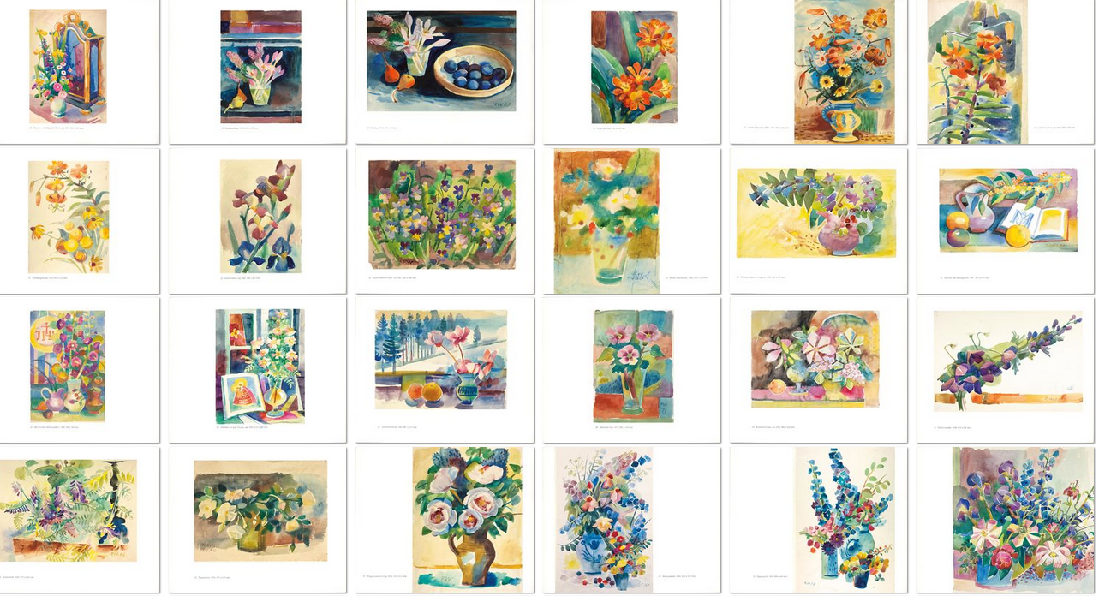

Slide 11
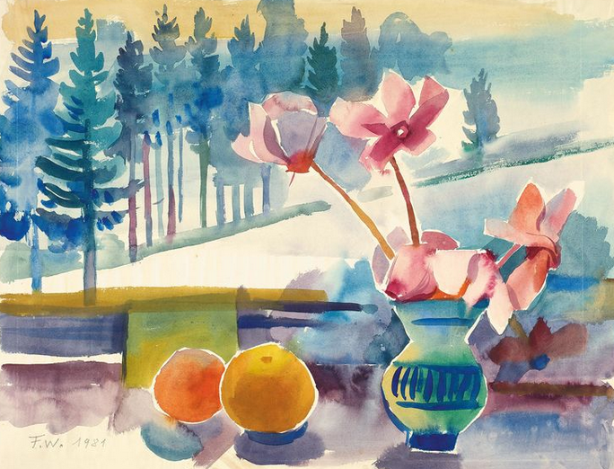
Link could go to any page of any book,
or to any web-page, or some interactive
application, as I
show next

Slide 12
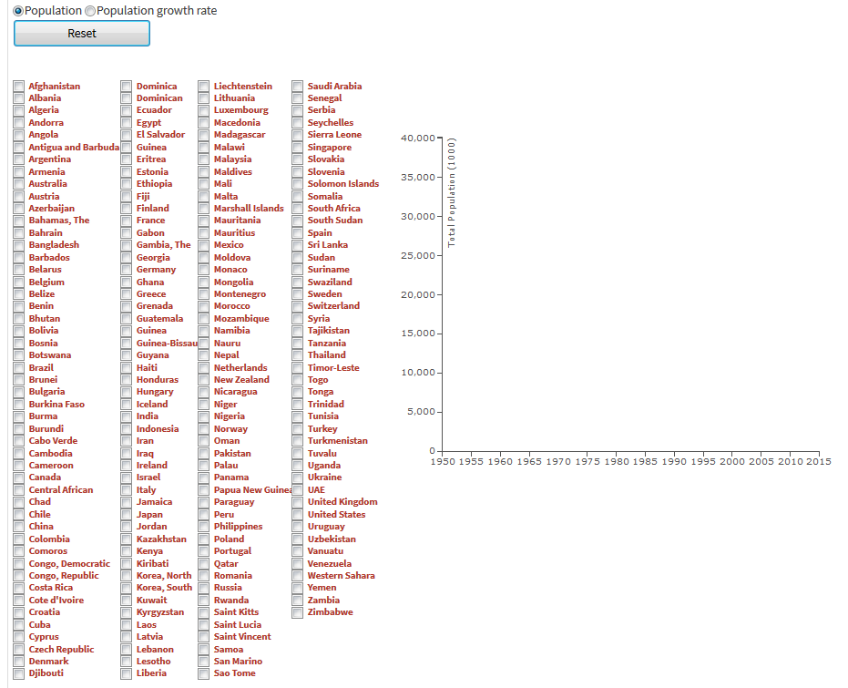

Slide 13
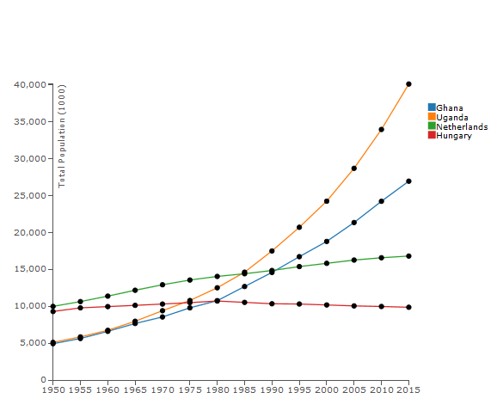
Population change
(1950 – 2015)
Ghana: 5 – 26 million
Unganda: 5 – 40 million
NL: 10 – 15 million
Hungary: 10 – 9 million

Slide 14
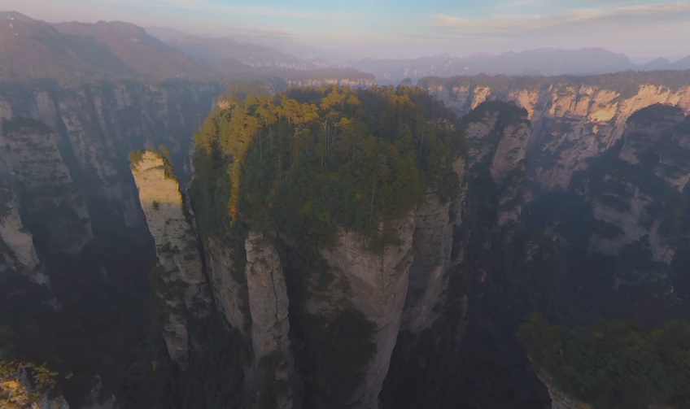
Avatar mountain in China – Interactive Movie
(by courtesy of AIRPANO.com)

Slide 15
Very important other properties (not all fully implemented yet, but will be ready by fall 2019):
--- two pages of same or different servers side by side
--- automatic generation and inclusion of quotes
--- transclusions
--- crucial for acceptance : conformity with IIIF standard
--- registration of users (bookmarks, etc.)
--- most important: each interactivity can be made to be seen by different user groups

Slide 16
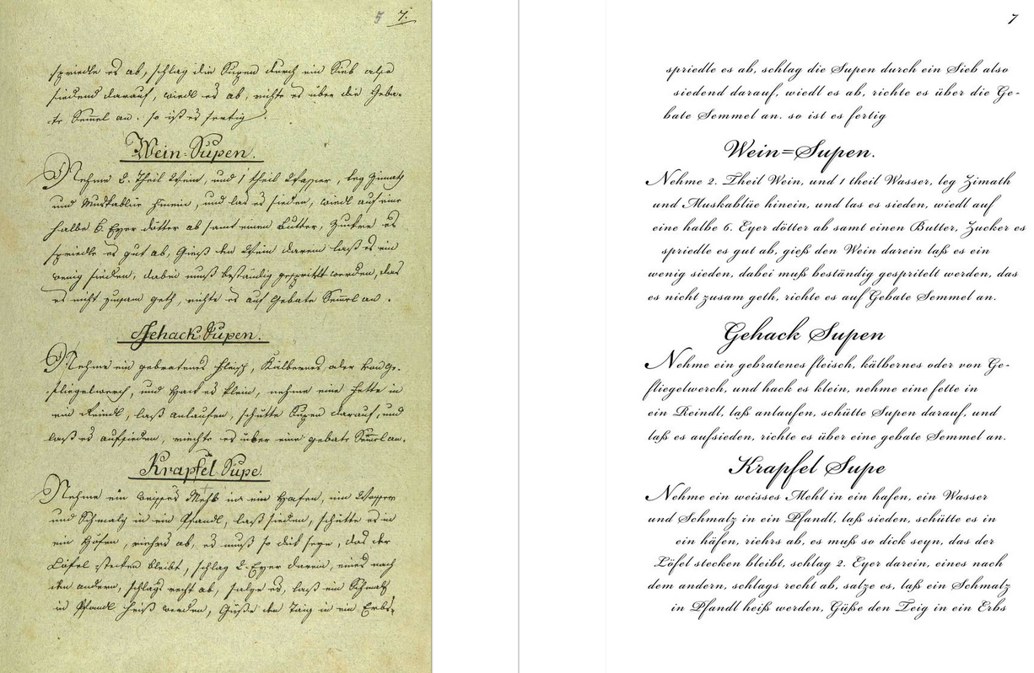

Slide 18
Very important other properties (not all fully implemented yet, but will be ready by fall 2019):
--- two pages of same or different servers side by side
--- automatic generation and inclusion of quotes
--- transclusions
--- crucial for acceptance : conformity with IIIF standard
--- registration of users (bookmarks, etc.)
--- most important: each interactivity can be made to be seen by different user groups

Slide 19
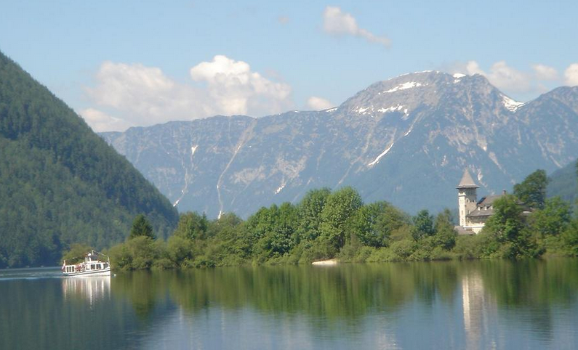
'Hart am See durchzieht eine Straße das nördliche Ufergelände meist durch Wald und an vielen reizenden Sommersitzen vorbei bis zum „Ladner". Verhallt sind Büchsen- knall und Liederklang der wackeren Schützen, welche hier so oft um ihren geliebten Prinzen Johann versammelt waren, doch lebt die Kunde jener frohen Zeit noch frisch im Gedächtniß der Bewohner und heute noch, wenn der rauhe Herbst das lustige Volk der Älplerinnen zur Thalfahrt zwingt und von allen Seiten mit Jauchzen und Singen bunte Scharen festlich geschmückter Burschen und Mädchen auf ihren Kähnen heranziehen, den Almtanz zu begehen, entfaltet sich beim Ladner ein Stück Volkspoesie, so unverfälscht wie ehedem.'
in: (1890): Die österreichisch-ungarische Monarchie in Wort und Bild, Steiermark, Seite 6, https://austria-forum.org/web-books/kpwde07de1890onb/00000018

Slide 20
Very important other properties (not all fully implemented yet, but will be ready by fall 2019):
--- two pages of same or different servers side by side
--- automatic generation and inclusion of quotes
--- transclusions
--- crucial for acceptance : conformity with IIIF standard
--- registration of users (bookmarks, etc.)
--- most important: each interactivity can be made to be seen by different user groups

Slide 21
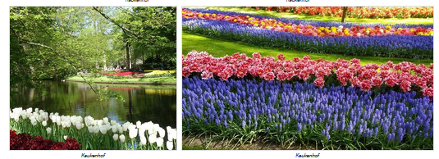
Keukenhof near Amsterdam opens 7 weeks a year in spring for a spectacular display of tulips (and other flowers).

Slide 22
How to include those pictures without copyright violation?
Obvious idea: Link to the page where the pictures are located
--- link may be illegal (!)
--- pictures will be part of other material that is not wanted
--- even if all is ok, user is stuck on the new page and does not know
when and how to go back to original story (see example on next page)

Slide 23
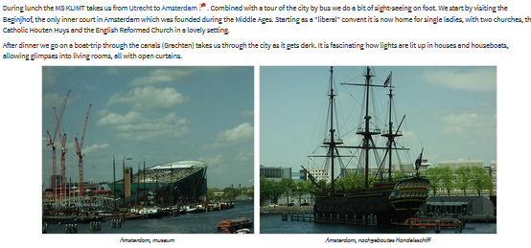
Keukenhof near Amsterdam opens 7 weeks a year in spring for a spectacular display of tulips
By continuing you go to the site https://austria-forum.org/af/Geography/Europe/Netherlands/Pictures/River_Cruise_Netherlands

Slide 24
Thus, a link is not good. One would need a link with information like: After a certain point on the page of the other site, return to were
you came from.
(For computer scientists: We want a „procedure call“, not a „goto“ !)
This is what transclusions are supposed to do: They lead to an other site, cleary specified what it is, but lead back a the point desired.
A transclusion would thus look like this from a user‘s point of view:

Slide 25
… Keukenhof near Amsterdam opens 7 weeks a year in spring for a spectacular display of tulips
Note: By continuing, you go to the site https://austria-forum.org/af/Geography/Europe/Netherlands/Pictures/River_Cruise_Netherlands
to see some pictures of tulips and flowers, but then continue in the current story.
Now you will continue with the main story you were in.

Slide 26
The idea of transclusions is 50 years (!) old (introduced by Ted Nelson)
but has never been implemented: There are both technical and
copyright issue that have to be resolved.
Easy for material on one server under one administration. Like on
our austria-forum with 1,1 million media objects and 2.300 digitized
books it is available. It would be easy for all books in AACE libary,
or all books by Springer, etc. But transclusions to cross into other copyright domains is tricky. Some of this will be discussend in
tomorrows opening keynote.
(For computer scientists: sites have to allow something akin
i-frames)

Slide 27
Very important other properties (not all fully implemeted yet, but will be ready by fall 2019):
--- two pages of same or different servers side by side
--- automatic generation and inclusion of quotes
--- transclusions
--- crucial for acceptance : conformity with IIIF standard
--- registration of users (bookmarks, etc.)
--- most important: each interactivity can be made to be seen by different user groups

Slide 28
IIIF = International Image Interoperability Framework ( https://iiif.io ). IIIF aims to cultivate shared technologies to enable interoperability across repositories, and to foster a market
in compatible applications. One particular popular viewer:

Slide 30
Very important other properties (not all fully implemented yet, but will be ready by fall 2019):
--- two pages of same or different servers side by side
--- automatic generation and inclusion of quotes
--- transclusions
--- crucial for acceptance : conformity with IIIF standard
--- registration of users (bookmarks, etc.)
--- most important: each interactivity can be made to be seen by different user groups

Slide 31
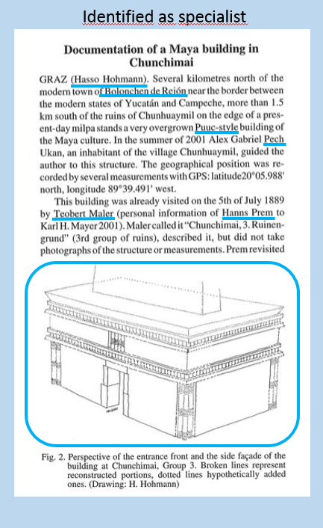
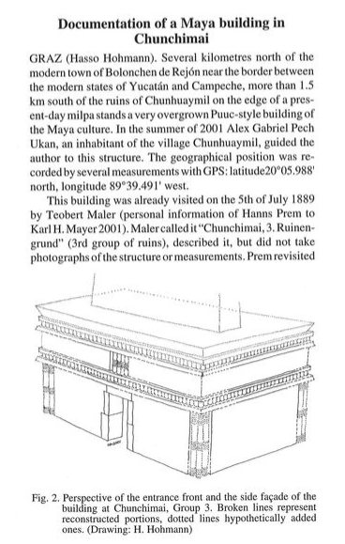
Anonymous view

Slide 32
Libraries of interactive books are changing the role of e-Learning systems and e-Books!
--- e-Learning systems: Often sophisticated systems using latest technology with e-Books as possible support. Problem: Change in technology requires change in software, or more
--- e-Books as libraries of interactive books provide an outline for any
learning material, can look different for different user groups, by linking
to external ressources (video clips, experimental labs, quizzes, tests,
data-bases with fancy interfaces, etc.) are arbitrary flexibel. But if one of the external applications does not work (is obsolete), replace it by a link to a new one. The core system requires no change of software.
To finish, allow me now to show you two unusual things

Slide 33
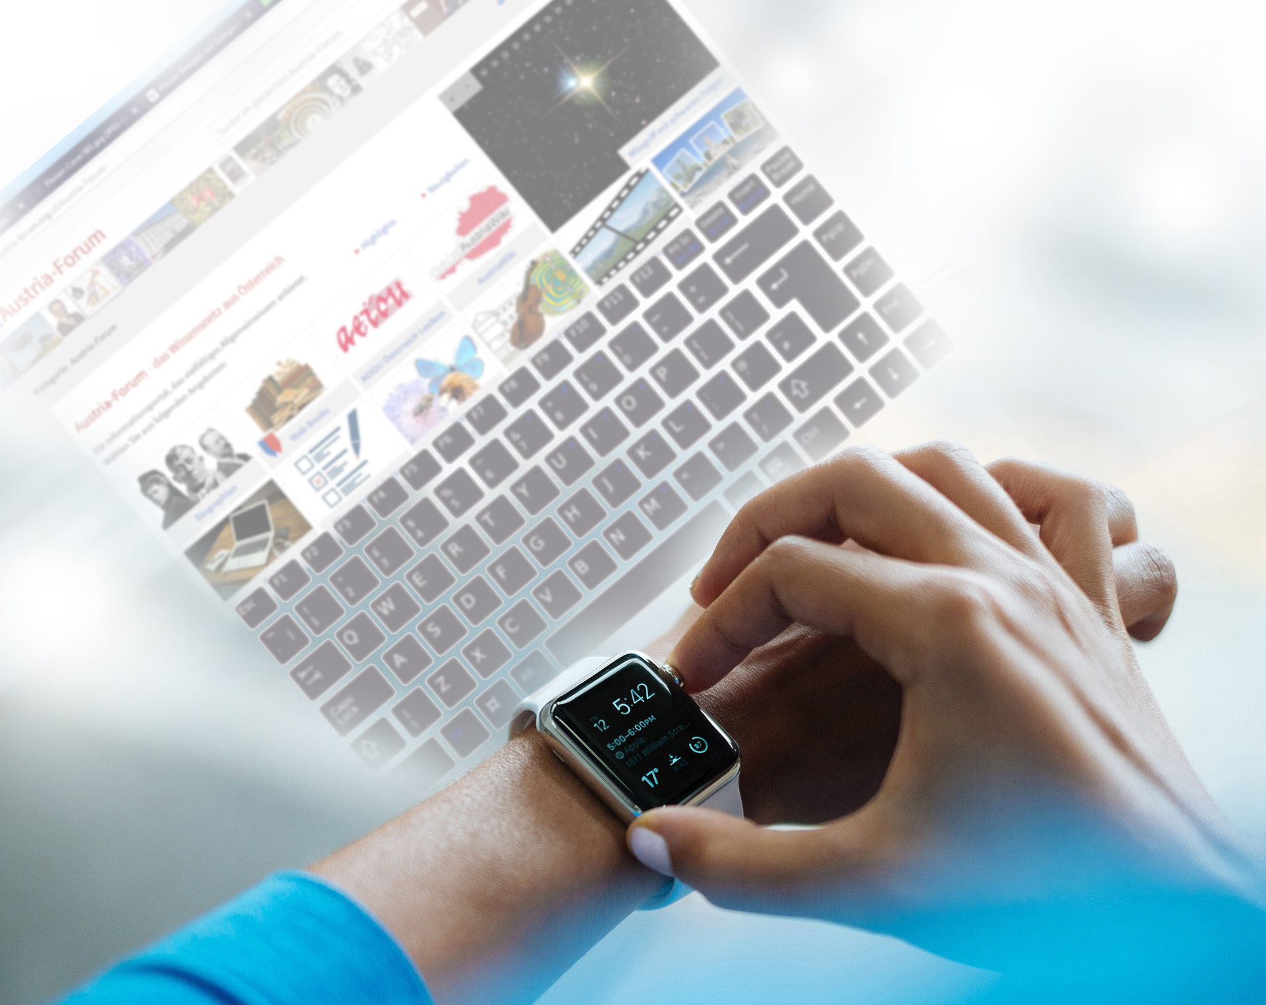

Slide 34
A „Business model“ for the use of drones?

Slide 35
If you want to try out a full implementation of interactive books in October,
drop me your email address.
My parameters are:
hmaurer@iicm.edu or hmaurer100@gmail.com
www.iicm.edu/maurer or www.ae-info.org/ae/Member/Maurer_Hermann
Thanks for listening!
Hermann Maurer

