Slide 1
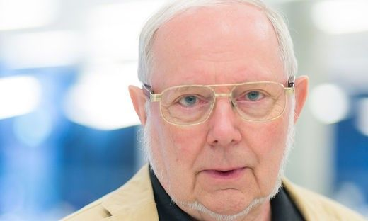
We need lots of imagination to solve some of the big problems facing mankind – and where does IT come in?
Hermann Maurer Graz University of Technology Graz/Austria Member of Academia Europaea
Presentation at EuroSPI 2019, Edinburgh, September 19

Slide 2
Main thesis: To solve big problems we need new ideas, lots if imagination: we cannot just treat symptoms, but have to attack the underlying issues.
I cannot present solutions to many important problems, but can show that imagination may lead to new approaches .
I am a computer scientist. But I start speculations in rather different areas,
and will turn to computer related issues later in my talk.

Slide 3
Let me start with an important question: Is CO2 our enemy as we often hear, or rather our friend?
In a way, CO2 is certainly our best friend:
--- Without CO2: There would be no plants, hence no animals, hence no life --- CO2 is not poisonous except in very high concentration
--- Concentration currently 0,04 % (400 ppm), rising rapidly from the 300 ppm we had for a long time, but it has also been 20x higher at other times
--- Increases growth-rate of plants
Also, CO2 is valuable raw material as will be explained a bit later.

Slide 4
Problems with CO2
Main issue in the public mind: As a green house gas it contributes to global warming.
(But so do methane, nitrogen oxides, water-vapor and others gasses.)
If we consider CO2 as enemy, the first question has to be: Where does it come from?
First answer is often:
Cars
--- Transportation related CO2 emissions are 20% (+/- 6%) of human produced CO2, less than half by cars (other human activities responsible for rest, e.g. cement production alone for 6%)
--- Human related green house gas emission amounts to 40% (+/- 20%) of all emissions
Putting this together: Cars are responsible for some 5% of global CO2 emission per year, i.e. a partial reduction of those 5% does not make a significant difference
Note: Figures for CO2 emissions vary a lot by source. Also, some gasses, although available in larger quantities affect the warming less than others, hence the +/- estimates. The total situation is more complex
than can be described here. One example should be enough: The large forest fires in Siberia in 2019 have created enormous amounts of CO2, yet the re-growth will take care of some of it!

Slide 5
In passing: Without green house phenomenon our planet would not be inhabitable: Average temperature would be – 15 ° C
CO2 is increasing global warming, yet the question remains:
Is global warming really bad / dangerous?
Are human activities mainly responsible for it?
To avoid discussions: Let us assume the answers are „yes“!

Slide 6
Attempts to stop global warming by reducing greenhouse gasses by a
change of transport or of food will not be enough.
Consider to emphasize CCS (Carbon Capture and Storage) and store CO2 as gas or solidified, or better still: use it as raw material:
--- CO2 essential for producing carbohydrates, but trees are not best choice!
--- With nitrogen, water and bacteria, fermentation can produce protein (hamburgers!)
--- Produce CO2 neutral bio-fuel like ethanol or methanol
--- Basis of many pharmaceudical products, all kinds of polymers, and more
I.e. don‘t concentrate on reducing emission of CO2, but rather on filtering and reusing it
But: Large amounts of clean energy are necessary for this. Wind, solar, tidal power, waterpower, bio fuels, geothermal energy … may help to bridge a gap. But the real answer is of course:

Slide 7
Nuclear technology
Between 2015 and today world-wide the no. of persons killed by car accidents is 4, 000. 000
Between 2015 and today world-wide the no. of persons killed by nuclear accidents is : 0
Currently : (Fission) Uranium reactors; Future: Thorium reactors; Fusion reactors.
Is nuclear energy for transport really absurd?
Don‘t forget: There is a fleet of nuclear submarines, aircraft carriers and icebreakers.
Or how about nuclear batteries. They convert heat generated in the process of natural
decay of an element (e.g. Thorium) into electricity. They are small, have no movable parts
and generate energy for decades or longer.
And have been used in large numbers! (Almost all space probes use them.)

Slide 8
Summary:
--- Nuclear energy is important to provide clean energy. --- Countries not using nuclear energy will import energy produced in other countries
--- Or import necessary nuclear technology at some stage
--- After 2030 Europe is likely to import LFTR (Thorium) reactors from China or India
--- Advantage of LFTR: no meltdown possible, radioactive waste is smaller, decays faster
Reason why research on LFTR reactors is lagging behind uranium reactors:
Military was/is not interested since they are not well suited for nuclear bombs!
As is: Probably a mistake to shrug off LFTR as source of clean energy.

Slide 9
However:
Fighting climate-change by just condering CO2, or change of food, or some cultural aspects, is treating symptoms, not the real problem.
The real problem is:

Slide 10
Overpopulation and further population growth
It is „taboo“ to talk much about the dramatic danger of over-population
Yet it will be the cause for dramatic shortages and more pollution
It will cause the largest migrations the world has ever seen
Let us start to stop or revert population growth and its consequences
Some figures:
World-population:
1900 --- 1 billion 1950 --- 2,5 billions TODAY: --- 7,8 billions
2050 ---10 billions 2100 --- 12 billions

Slide 11
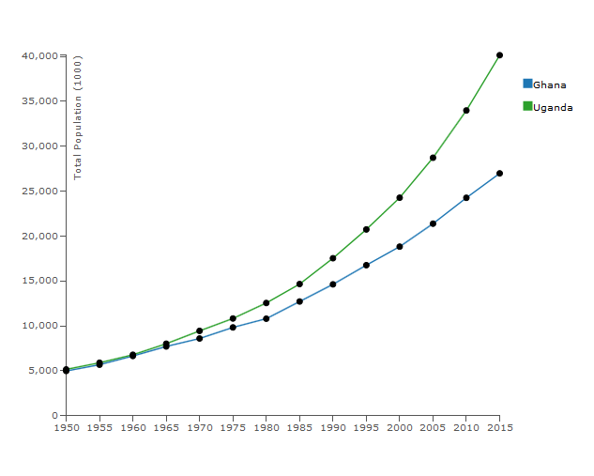
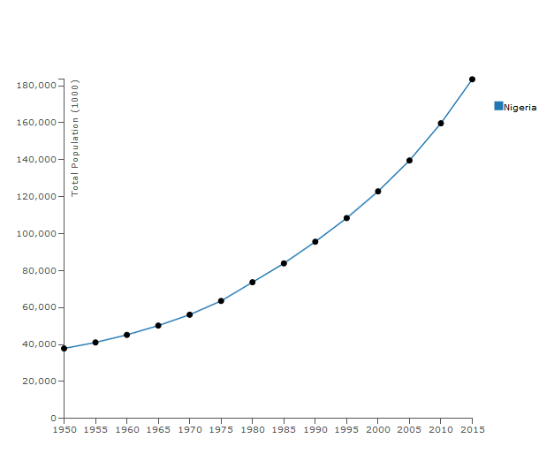
Uganda increased from 5 to 40 million
Between 1950 and 2015
Nigeria will have 440 million people
(more than all of Europe) by 2050.
200 million or more will want to
come to Europe for a better life

Slide 12
Looking at this in another way is even more scary: --- Annual population growth in coming years: >1 % --- Annual standard of living growth in coming years: 3%
Consequences:
--- The mantra „economy has to grow by 2% or more each year“ has to be
given up
--- Models for stopping population growth and slowly (over a few centuries) reducing population to acceptable levels ( < 4 billion) and providing decent
living conditions for all are needed
Do such models exist? Yes, let me show two of many

Slide 13
Proposal 1: Rich countries triple amount of money given to developing countries. HOWEVER:
The money does not go to some (corrupt) governments but to an international organisation. Money goes to families with at most 2 children and only for:
--- medical treatment
--- and a guaranteed pension from age 65 onward
The motivation: „many kids“ for support of parents will thus disappear.

Slide 14
Main reason for population growth in e.g. Africa: Very young women have already many babies. To work against this:
Develop an injection that sterilizes a young man or woman for
(say) 5 years. To make acceptance of injection attractive,
receiver gets 2.000 Euros. Two such injections will mean: a girl
can have children after age 25, but not already five as is now the
case in some countries.
Positive side effect: Young women have time for education!
Note: Pharmaceutical companies will fight this approach. Selling one injection
ever 5 years is commercially not profitable compared to selling pills throughout.

Slide 15
Proposal 2: With the money from richer countries desalination plants are built where ocean water is not far from a desert.
Per head and day 25 l clean water is providable with current techniques at a cost of some € 5.- /day. (Less than the cost for maintenance of people with acceptable living conditions.)
Yet this is enough water for cleaning and cooking. Waste-water used for
simple agriculture (vegetables, corn, chicken, goats,…).
In shallow bays: Blue algae (cyano bacteria) are grown, consuming much CO2 and producing valuable raw material.

Slide 16
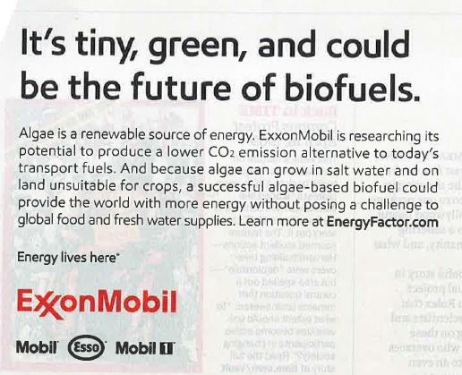
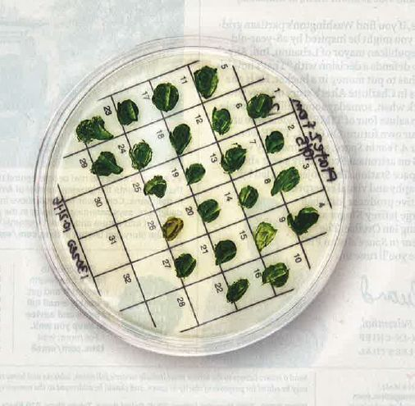
Algea consume 10x more CO2 then ordinary plants, yet provide food, pharmaceudical products, fuel and more.

Slide 17
Idea of Stephen Hawking:
More room for mankind by colonising space.
Colonising space: A great dream. Yet in our solar system few planets will be seriously colonisable. Mars maybe? Parts of the moon (sub-surface)?
There are, however, quite likely a few usable planets within a 20 light-year
radius.

Slide 18
Is a distance of light years manageable for humans?
The situation is discouraging:
--- The fastest speed of a space probe that was ever attained so far was
300.000 km per HOUR , i.e. 0.03 % of the speed of light
--- The space probe Voyager has been underway for 40 years. It is now
at a distance of some 20 light hours. Voyager will reach a different solar system (Sirius) in 160.000 years
--- A space probe that would obtain on its own just 1% of the speed of light
would be an incredible sensation (with a futuristic photone-engine and energy
generated by a fusion reactor).
Note: Ouside support („pushing a probe by a laser“) may allow relativistic speeds for small objects.

Slide 19
Now let me talk on a topic closer to our times: Traffic
Discussions often deal with individual traffic versus public traffic and how
transport should be powered: combustion engine, e-mobility, hydrogen, …?
My conviction: We should not give up the great invention of individual traffic,
BUT:
--- Current cars are an unacceptable compromise between one-person short-haul transportation, and vehicles carrying a larger group, like a family, to an excursion/ holiday
--- Long distance freight must shift to trains

Slide 20
First radical solution:
Massive increase of tax on fuel and size of cars, revenues for research and other measures (to be explained in a minute).
Advantanges:
--- Favours smaller cars with low fuel consumption
--- Persons and freight move to trains where possible
--- Rental of larger car after train trip or flight possible, yet possession of large car starts to be unattractive

Slide 21
30 min
My 30 year old favorite model for a small car is the Mini-Auto (Mauto).
The Mauto is built for at most two persons sitting behind each other. Can be
coupled with one or more behind, electronically.
It travels separated from heavy traffic on „one-way big bicycle trails“. You do not
own Mautos: They are ordered by smartphone and come to you autonomously,
drop you off where you want.
Of course there are problems to solve for autonomous traffic: handling coordination with heavy traffic, ambulances, fire-fighting engines, delivery of large freight, building machinery, etc. Let me state: all is doable, but this is another talk:
https://austria-forum.org/af/Wissenssammlungen/Essays/ Mobility/Skizze_für_neuen_Personenverkehr

Slide 22
Some rebuilding of the road structure will be necessary for Mautos. Yes, but this also applies to autonomous cars: Those will function well only
if they move on roads with a tight control of all other traffic.
Other ideas for traffic:
--- Why do we walk on sidewalks, why don‘t they walk for us (like travellators in airports or escalators in some buildings)
--- Why is everything tied so much to the ground?
--- Why not more gondolas, drones for delivery, autonomous small freight
boats, air ships for point to point transport of large objects?
--- Drones will be good for some surprises --- Can Virtual Reality reduce traffic?
--- Reduce globalisation, bet more on regionalisation and saisonalisation --- Flying cars?

Slide 23
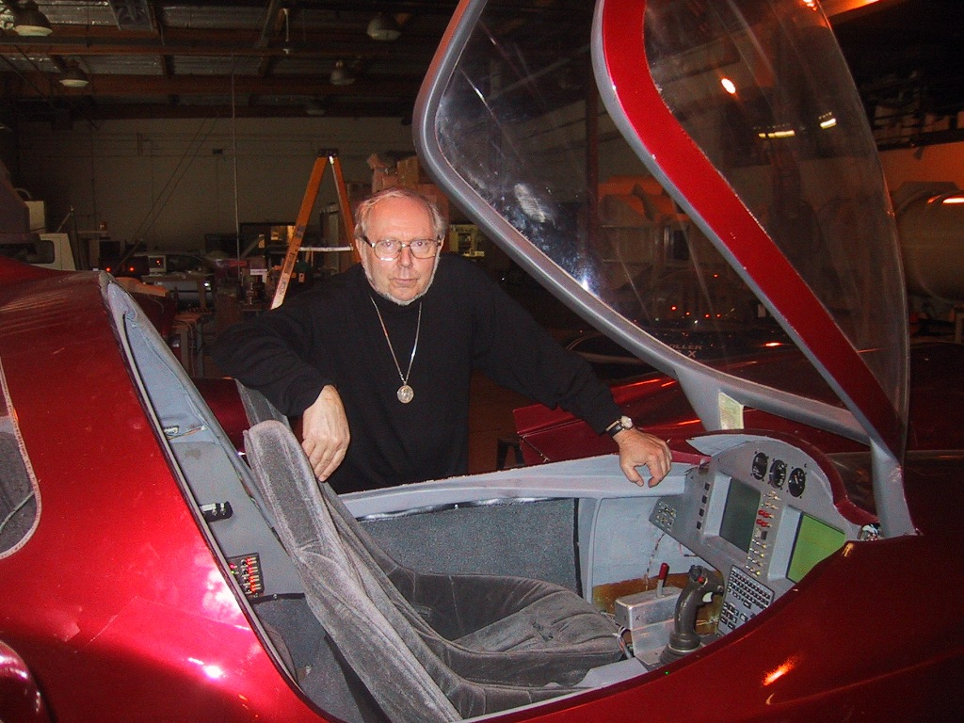
Flying cars have been
around for a long time.
Even vertical take-off
and landing models
like this Moller in
which I flew over
10 years ago!
www.moller.com

Slide 24
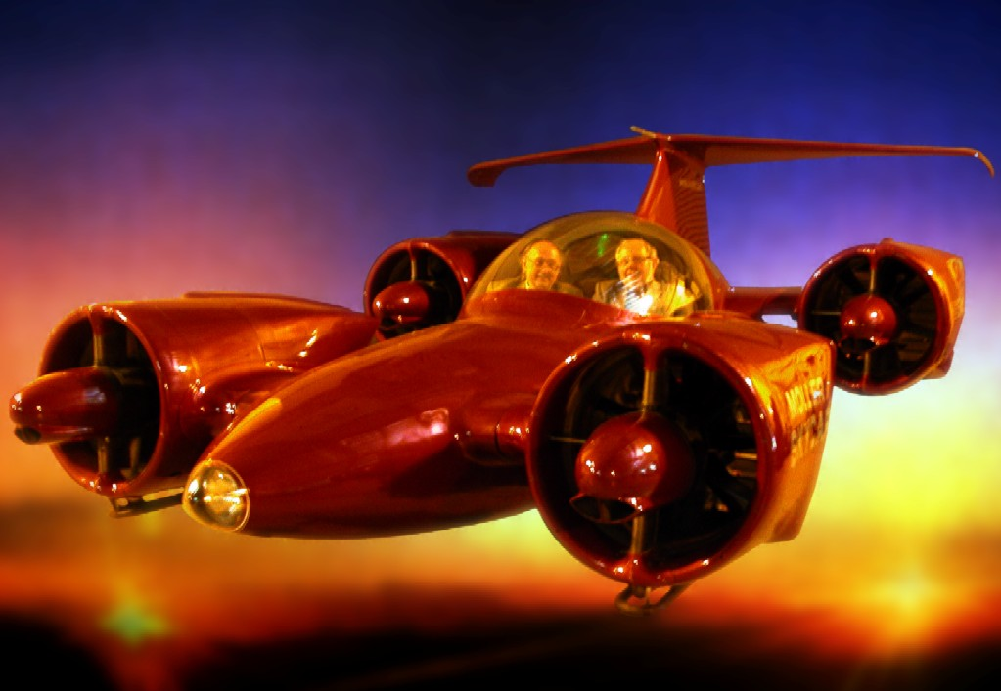
Flying in a Moller with
Professor Gio Wiederhold,
Stanford.
Moller is allowed on roads,
but otherwise only in very
restricted areas.
Problems: What is it, where
is it allowed to take off,
to land, to fly?
Airoplane?
Helicopter?
Take off where?
Landing where?
Any route?
www.moller.com

Slide 25
Let me now turn to Big Data Analysis.
Idea: Analyzing big amounts of data yields interesting results and correlations.
Big danger: Correlations can be not causal, but spurious. (Seminal paper by Cris Calude)
My favorite fun example:
Per head there are more storks in Burgenland (an Austrian province) than anywhere else in Austria. Per head there are more babies in Burgenland than anywhere else in Austria.
Thus: Storks are responsible for babies, as all young kids are told in Austria.
Unfortunately, there are more subtle cases, where correlations are taken serious.

Slide 26
Statistical significant:
--- There are areas where the ocean-water is very clean
--- Those clean areas are the areas with a significantly higher rate of piracy
Thus: Clean ocean-water supports piracy ???
Of course the truth is more complicated: There are fairly remote (and hence clean) areas in the Pacific (like between Samoa and Tokalau). Hence pirates can act there quite undisturbed.
Thus the real connection is: Remoteness encourages piracy.
That the ocean is fairly clean in those areas is just a by-product of remoteness.

Slide 27
A similar case, but this one very often misinterpreted:
--- Car-traffic produces CO2
--- Global temperature is rising because of more CO2
Hence: Car-traffic increases CO2, hence let us restrict car traffic
The real reason is much deeper as I have explained:
--- More people and a higher standard of living implies more ressources, more cars and production of more waste. Since 1950 and today population has more than trippled (2,5 - 7,8 billion) and the number of cars even more… so what can you expect???
Hence: Global warming is not caused by cars, but by the dramatically growing size of population and growing living standards.

Slide 28
Now let me turn to a question I am often asked: Do computers and the internet undermine our cognitive capabilities?
I guess we all agree that this is the case to some extent, like:
We are not good at arithmetic any more since our smartphone has a calculator
Our memory is suffering because we can look up everything on the net or Smartphone
Our capacity to write is reduced, since we can copy/paste easily
Our spelling gets worse and worse since spell correctors help us anyway
Our reading (particularly of complex material) gets worse, because we communicate
more and more visually, and Google provides the answers in spoken form
Is it still necessary to learn anything, if we can read up all we want to know?
Do we still need to learn complex connections when AI is helping us more and more?

Slide 29
“The Internet offers incredible amounts of information, pearls and nonsense. Bored users fill their cursors and brains with irrelevant data. They lose the ability to select, to discard, to think and to judge”.
(The University of Google, 2007)
29

Slide 30
“How Blogs, Facebook,
YouTube, and other content
provided by users in the Web
are destroying our economy,
our culture and our values”
(First edition 2007)
30

Slide 31
“How the digital age is making young
Americans stupid and is endangering
our future
(Or: “Don’t trust anyone under 30”)
Communication technology
creates a barrier between
generations. Young people
have only one main aim:
to be „in“.
by Mark Bauerlein
(Erstausgabe 2008)
31

Slide 32
The Net “fragments content and
disrupts our concentration”.
“..the way people read and write
has already been changed by the
Net. It and social media contribute to the ecosystem of interruption
technologies”
(2010)
32
Notes:
32

Slide 33
„We need computers for teaching in
schools as much as we need bicycles for teaching how to swim“
Actually, Spitzer is a bit less radical than
above quote: To teach early on how to
use computers/ the web properly is ok.
But an iPad for every student? NO!
(First edition 2012)
33

Slide 34
Examples are quite scary!
One consequence: We must assure that creative thinking and creative
person to person communication is not destroyed.
However: We also must accept that many cognitive facilities mentioned will be reduced by computers, smartphones, the web.
But this is not quite as bad as it sounds!
34
Notes:
34

Slide 35
We need a new interpretation of what a human being is: It should not be viewed as something purely biological but as symbiosis of biology and technology.
Humans must be seen together with all tools they are using, external or internal.
Example: Hermann Maurer.
He is deaf, needs glasses to see things in focus, has a pacemaker, and an artificial hip, and will soon need new knees.
Without those tools: He will be crippled or dead. As is, he still feels quite alive.
35
Notes:
35

Slide 36
This is not a new phenomenon. My grandfather was able to run with a heavy load faster and further than I ever could. Yet I beat him:
I put more stuff than he could ever carry into my car and transport it
further and faster than he would ever have been able to do!
We must accept: Technology has always led to the reduction of some of our capabilties. And this is quite OK if:
(a) Our loss is overcompensated by technology
(b) Our creativity, our feelings, our humanity remains, and
(c) A complete breakdown of technology cannot lead to a global catastrophy.
36
Notes:
36

Slide 37
I have written some 50 Science Fiction Books over
the years. One („The Paranet“) is on such complete
electronic breakdown.
The first 7 chapters are realistic. Forget the remaining
5 chapters: I save mankind when in reality there
would be no way to save it.
The book is sold out, but if you are interested:
Note or I send the URL
https://austria-forum.org/web-books/xperten09en2004iicm where you can download the PDF
Just write to me : hmaurer@iicm.edu
37
Notes:
37

Slide 38
Let us now turn to another aspect: Automation
It is clear that it will continue. There is always the discussion whether it will
destroy jobs. Most argue that it will create sufficiently many new ones.
This is just a lie! My grandfather worked about 3.200 h / year. Today the typical
Austrian fully employed person works 1.600 h/ year. And this will further
decrease. (In 50 years: 9 weeks holiday per year, 24 hours work per week.)
Discussions often involve AI and complex tasks, but of course the majority of
jobs in banking, in administration, in public transport, …. etc. will disappear.
We better start to believe that AI gadgets will replace humans more and more.
What should we do when jobs will disappear on a very large scale?

Slide 39
One thing governments have been doing to retain a large
number of job is to create „pseudo-work“
Examples:
--- Collecting money from cars in many ways (when you buy it, when you buy fuel,
special insurance, sticker to drive on autobahns, special fees for going through tunnels,
fees for parking, ….)
--- Administration for hundreds of unnecessary tasks (filling out questionaires, EU data protection laws, ...)
…
Typical example: Austria had 60 million people till 1918, administered by people in Vienna. Austria shrunk to 6 Million in 1918. The number of government employees did not change: They were very clever in creating unnecessary work for each other…
Stop unnecessary work. Let us be happy if there is less work to do. But distribute remaining work and related income in a just way.

Slide 40
Don‘t be afraid of not enough work. Working for money does not make happy. Working towards a positive goal does!
We have to recognize talents of children als soon as possible to educate them the right way.
--- For the communicative types who care for others make sure they are led to jobs dealing with people: Teachers in schools and kindergarten, medical helpers, helping handicapped persons, looking after sick or lonesome or elderly people, ….
--- For those with manual talents: Let us revive handicrafting, repairshops, repair rather than displace prodcuts, small scale gardening, create art, regionalize rather than globalize
--- For intellectually talented: Academic career as doctor, as engineer, as researcher, as inventor, ….
My conviction: Computers will lead to a wave of unemployment unless we define a number of alternative types of work as indicated. Otherwise, we are going to produce a wave of unemployable academically trained persons.

Slide 41
Summarizing: Automation will change our economy dramatically
This will require a re-distribution of wealth and and of work, or we will be confronted with serious justified social unrest.
Let me now briefly mention the problem of instability of digital information,
due not to failures, but simply changes of formats, HW and SW.
I experienced this because some 40 years ago I was involved in „Interactive Videotex“ (Bildschirmtext or BTX in Austria and Germany), a kind of pre-cursor of the Web, now long defunct and forgotten.

Slide 42
B.T.W, unfortunately, some important features of BTX were not incorporated into the Web. In BTX:
--- Anonymous offers were impossible. All information came from registered organisations or users, with known persons one could contact
--- Anonymous mails were impossible (no SPAM, no problems with malware,…)
--- Pages could have minimal fees

Slide 43
Graphic images were possible in BTX.
A young artist (Daniel Rozenberg) created cartoons for BTX in 1982. He is by now the famous Dutch cartoonist „Dardara“.
For his biography he asked in 2017 if he could get some of his early work for the introduction. But BTX had closed down some 20 years ago!
The attempt to reconstruct some of his cartoons worked by chance, but was
a tremendous effort.

Slide 44
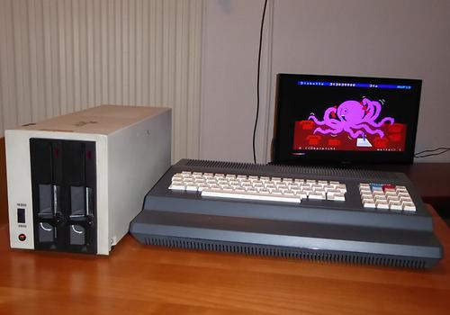
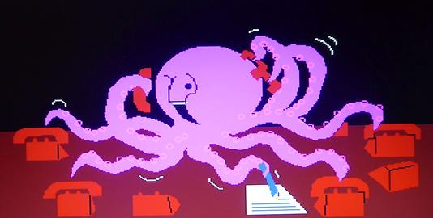
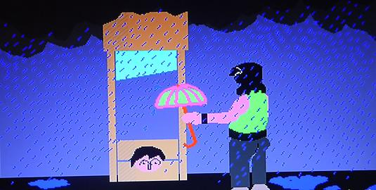
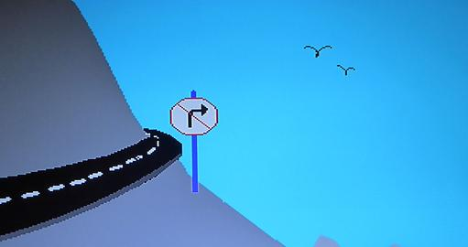
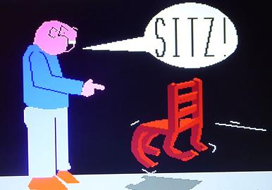

Slide 45
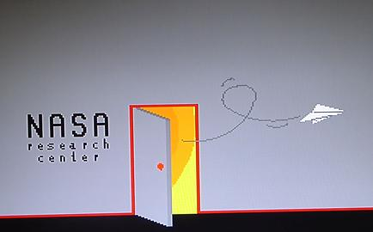
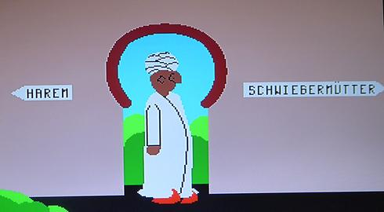
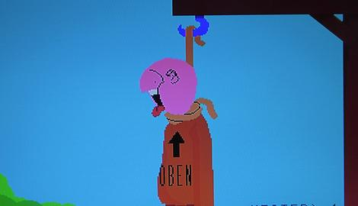
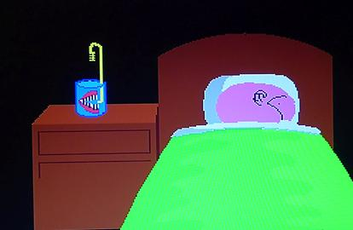

Slide 46
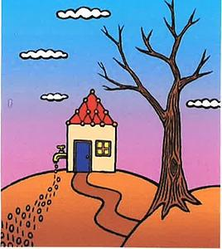
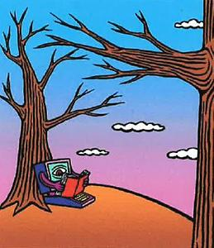
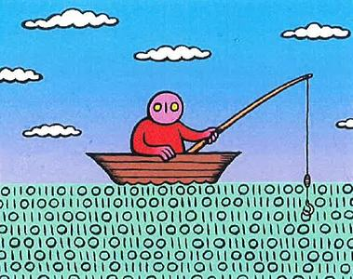
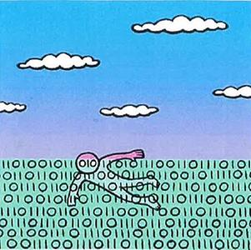
Data mining
→
Information leak Machine Learning
In this case it was possible to restore information.
However, developments in HW, SW, formats, interfaces etc. will assure that much of the information we have today will be lost before long.
This is even true of PDF. It is an unsolvable problem (?) right now for 3 D or interactive information.
Drowning in the sea of information

Slide 47
To combat fake news or slanted news we need trustworthy portal-servers
in all countries:
A recent recommenation in a report on those issues to the EU parliament states:
„We are in the danger to move from a fact oriented society to an emotion oriented society…the only way to combat this is by having portals with truly trustworthy information.“

Slide 48
This is the kind of research I am involved in: Building a new kind of portal server, by now with over 1,1 million media-objects with properties such as:
--- contributions have authors with CVs accessible, authors can be contacted anonymously, but even so they can answer (!)
--- users can comment identified or anonymously
--- thousands of digital books are incorporated, a link from a contribution to a chapter in an authoritative book can confirm its quality
--- book-pages and web-pages can be mutually linked to strengthen reliability of information
--- searching by topic leads to snippets of relevant information from many sources (AI!)
--- answers are provided with the definitions they are based on
I believe we will have a SW for a truly intelligent portal server/ digital library available by this year‘s end

Slide 49
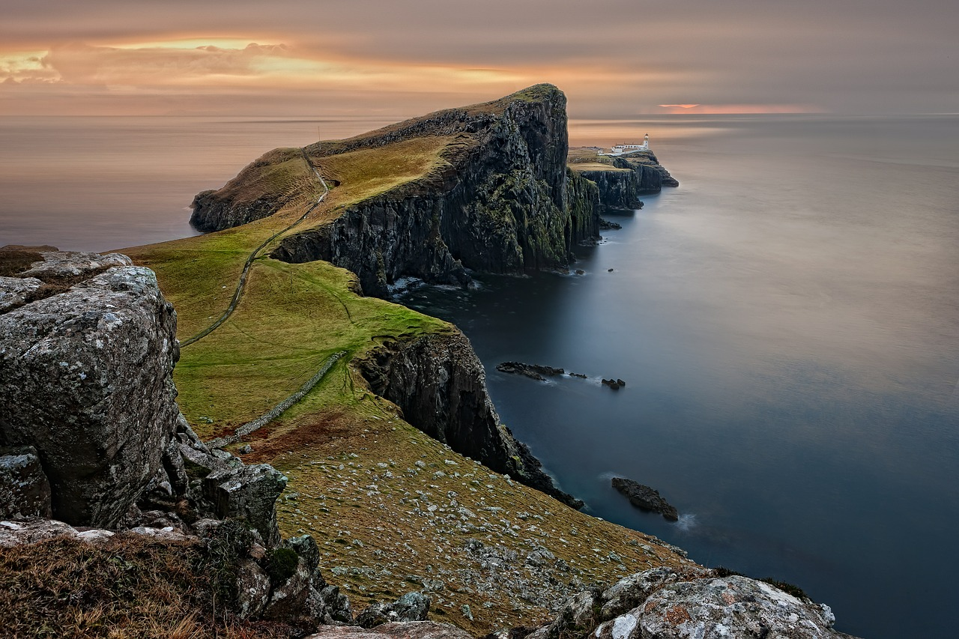
If you are interested in the system, contact me at hmaurer@iicm.edu or have a look at a prototype at http://austria-forum.org
Thanks for your attention and giving
me the chance to re-visit beautiful Scotland
Hermann Maurer

